Slide 1
Río Claro
Colombia, roads for peace

Slide 2
THE DRIVING FORCE
This project is a dream I have pursued for a long time. I have lived in Spain for thirty-two years and I’ve never accomplished addressing on stage issues about my native country, where I lived for twenty-three years. I feel very humbled by the prospect, it feels particularly daunting because I don’t live there. There are others who both suffer and enjoy that land and there are other people who can talk about these matters firsthand and probably better.
However, due to the plebiscite that was voted in Colombia regarding a peace agreement with the FARC, on October 2nd, 2016 (my birthday), when the no to signing that agreement won by a negligible majority, all the feelings of uneasiness and impotence rose from my body: all those feelings I had until then accumulated erupted like a volcano and I had the enormous need to talk from here (Spain) about what was happening there (Colombia).
Why did people vote no to peace?
Furthermore, a large percentage of that no was voted abroad.
Added to that desolation was the rage I felt at hearing comments people made about US TV series “Narcos”, how people loved it, they ‘digged’ it... they found it amusing.
Why is it that for many we are just a third world country, violent, that traffics in drugs… and nothing else?
And, according to some sources, even in the selfsame UN an argument used there is that all that happens in Colombia ‘is up to narcs’, so no investigations on the multiple massacres, the forced relocations and the reiterated violation of human rights are ever carried out.

Slide 3
Right now, in full confinement due to the pandemic, the massacres of civilians, young boys, farmers, indigenous people and social leaders have grown exorbitantly.
Little is known here about the Colombian conflict. The ordinary citizen only gets the general information offered by the press and TV: numerical data, disaster images, unemployed people...
Very few citizens have a more real vision about what happens in Colombia (and not only in Colombia: in ALL
Latin America).
In the theatre we don’t develop sociological theories, we don’t develop statistics. In the theatre we search for truth within the stories we tell.
We have to go inside the stories we tell, with our five senses, and have a conversation about what is wonderful about us, our passions and delights, about the battle for keeping a dignified life.
How Doris, ex-guerrilla, may have formed a family with Evelio, a soldier, and live in peace.
Or how Alfonso, ex-paramilitary, has found a job in the middle of a community that is victim of a massacre perpetrated by the paramilitaries.
Maybe this way, telling this stories, we can contribute in a small way to the peace agreement. Favor a conciliatory look about the men and the women who have ran away from poverty, misery or violence, and go from the altered information to a sympathetic awareness about their lives: push away the stigmas and then get closer to the people.

Slide 4
Ecosystem
Colombia is considered the second most biodiverse country in the world. Its ecosystems are distributed in all regions of the country: Andes, Caribe, Orinoco, Amazonas and Pacífico.
It is estimated that in Colombia there are about 467 species of mammals, 1,821 species of birds, 623 species of amphibians, 3,200 species of fish and 518 species of reptiles, of which about 18% are endemic.
There are a total of 8 ecosystems in Colombia:
barren plain, savannah, desert areas, tropical
forest, mangrove swamp, coral reefs,
seagrass beds and pelagic ecosystem.
These are in turn divided into terrestrial ecosystems and aquatic ecosystems.
Photo by : National Geographic®

Slide 5
T HE ENCOUNTER
Our eleven person team has carried out, in the middle of the pandemic, on digital platforms and through ten sessions, a journey across the river, the jungle, the desert; the many-sounding voices: leaders, peasants, black people, indigenous people, people of the plains, soldiers, women-girls, men-boys, victims, murderers, exiled people, displaced people…
We based our work on the book of interviews ‘Forgiving the unforgivable’ by Colombian journalist Claudia Palacios, and on several short stories compiled by Colombian journalist and sociologist Alfredo Molano in various books. Also, in documentaries and journalistic information from the last ten years.
We speak of Truth, Justice and Reparation. We go from documentary to fiction.
The air our work breathes is given by them: the women-girls.
The blaze of data has been enormous due to the over fifty years of duration of the armed conflict. The selection of stories has been thorough, step by step; we wanted to speak about the light that springs up from that land. We wanted to reach the audience’s ears from silence; then graze them with whisperings, get them into the sunrise that happens at night; for them to
sniff at and savor that ‘other’ that has seen their self immersed in the chaos of a civil war and has built within some kind of order to be able to survive.
The dream has started to walk. Eleven artists speaking of love and not of war.

Slide 6
ABOUT THE DRAMATURGY
The creation of the text for this project is an elaboration of the dramaturgy based on the work of the whole team. As a group we have investigated, we have learned about, we have conducted approaches to the dramatic text, the creation of characters, exploration of images and the concision of a shared poetic universe. The spaces, actions, images, lighting and sound brought up in the text originate from this precious work. In said exploration there is an overlap of multiple layers of writing, performance exercises based on exercises suggested by the set designer, of lighting initiated by the light designer or sound effects triggered by the project musicians. A complex and rigorous journey of team dramaturgy, not only understood as the creation and development of a text, but as a whole that grows and is completed as a group from the start.
To speak about forgiveness, about truth, reparation and justice in the Colombian armed conflict, is to talk about collective processes; and that WHAT required an eloquent HOW equal to the task.

Slide 7
Colombia, officially the Republic of Colombia, is a unitary republic of America located in the northwestern region of South America. It is constituted in a social and democratic state of law whose form of government is presidential.
Population: 50 million inhabitants.
Surface: 2,129,748 km² made up of continental territory and maritime waters (larger than the entire Iberian Peninsula).
Colombian nominal GDP is the fourth largest in Latin America and ranks 30th worldwide.
More than a hundred popular festivals are celebrated a year and NO ... Colombia does not have 4 climatic seasons, the climate depends on the thermal floors, it only has two seasons: wet and dry.
Demography

Slide 8
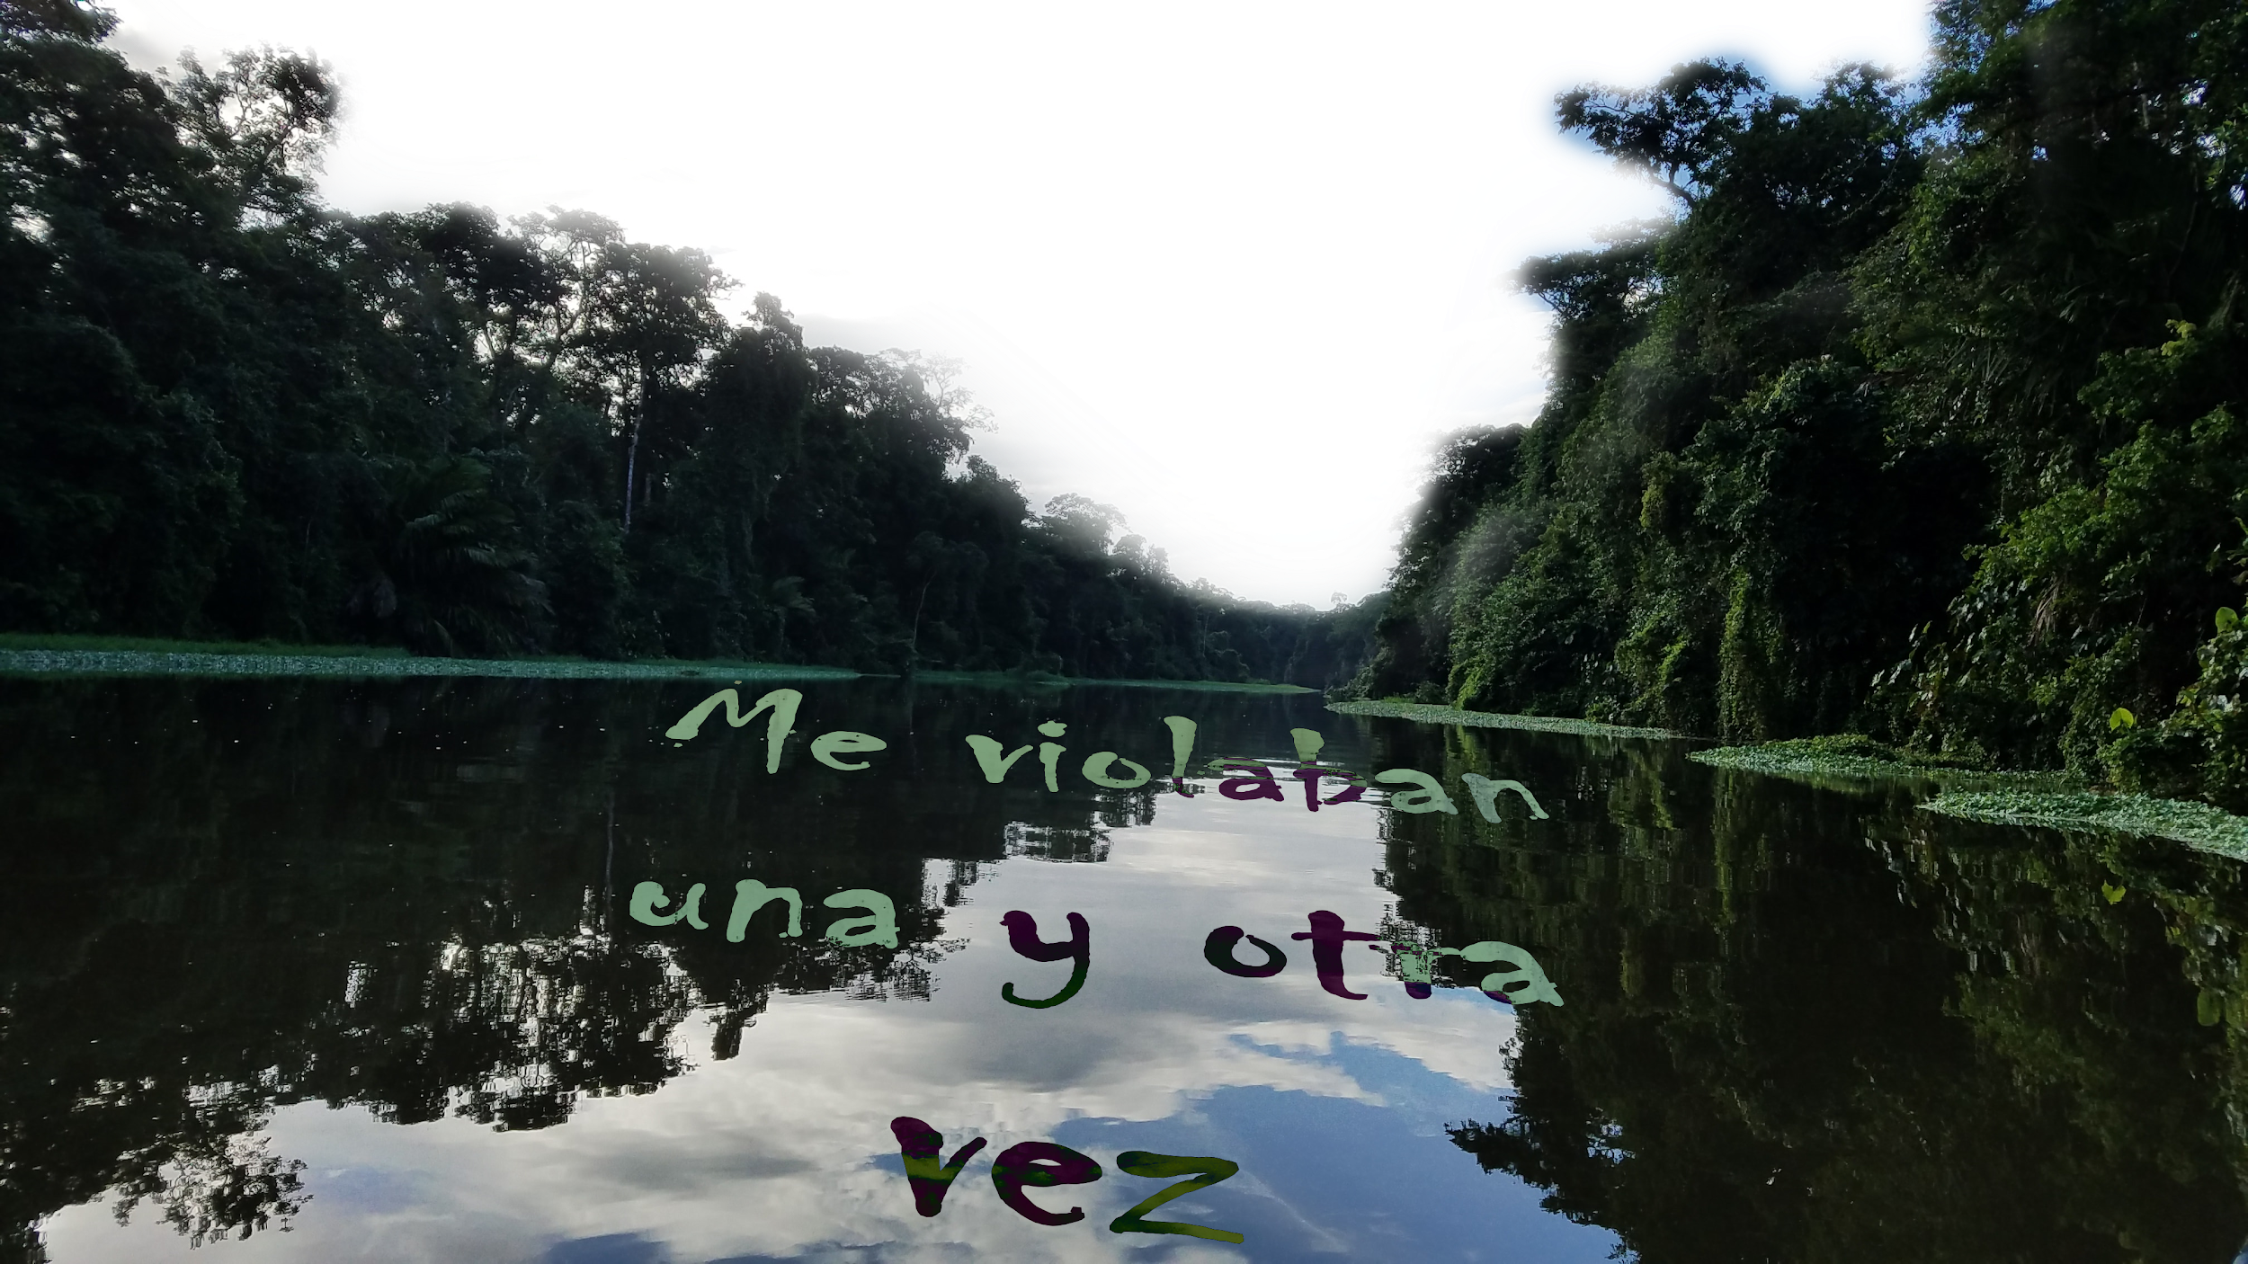
S P A C E S F O R T H E P E R F O R M A N C E , based on nine concepts :
Nature

Slide 9
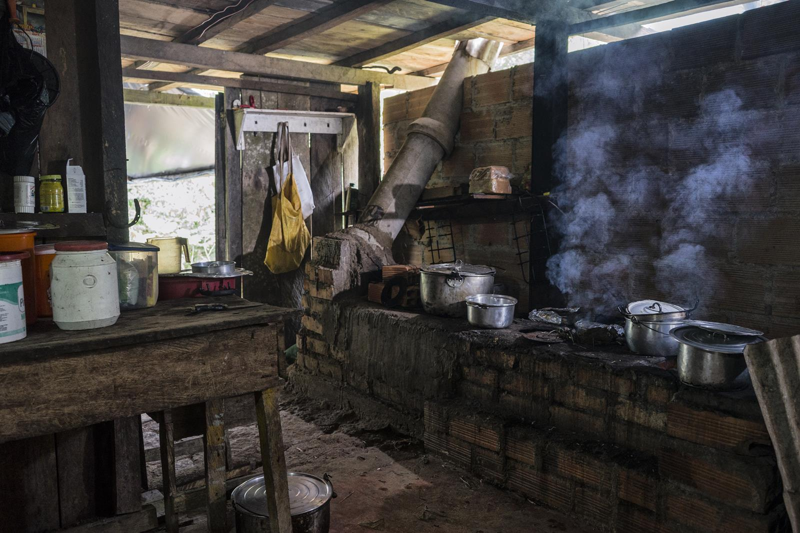
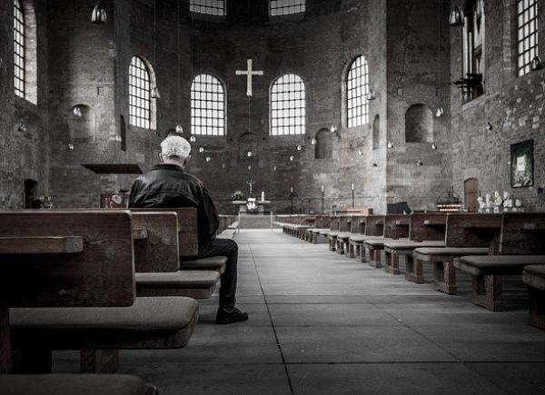
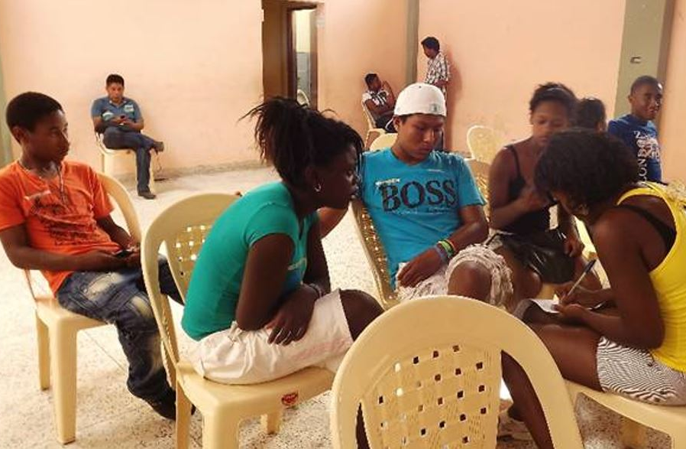
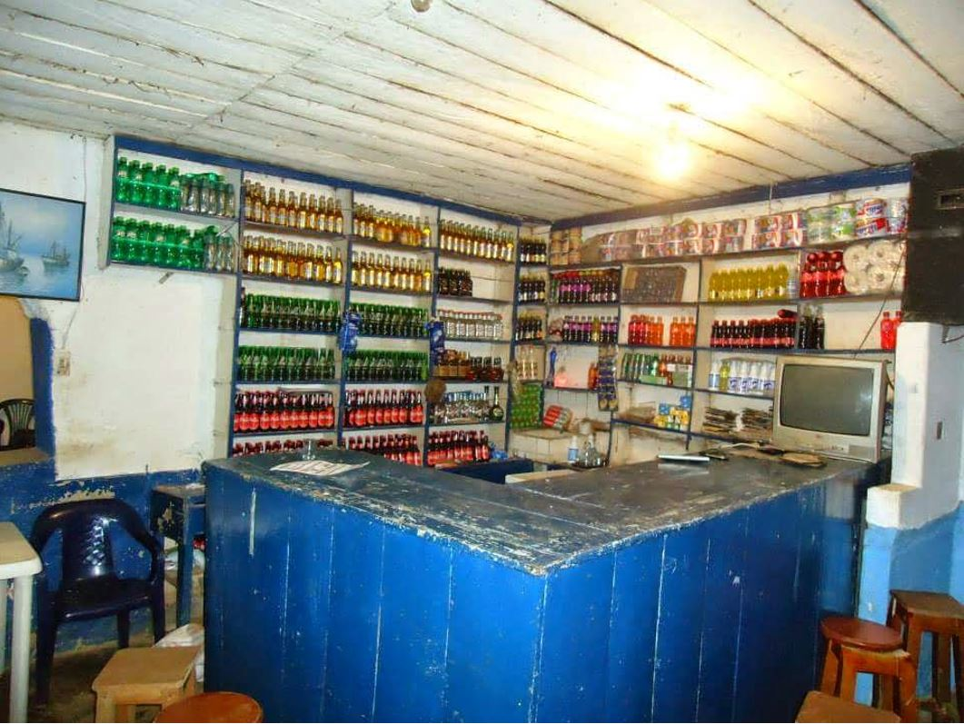
2.
Private
home.
3. Parish.
Concept: The dream of flying
Concept: Who will come to save me?
4.
Social
home.
5.
Club, canteen.
Concept: Tell me what is peace.
Concept: Neither good nor bad .

Slide 10
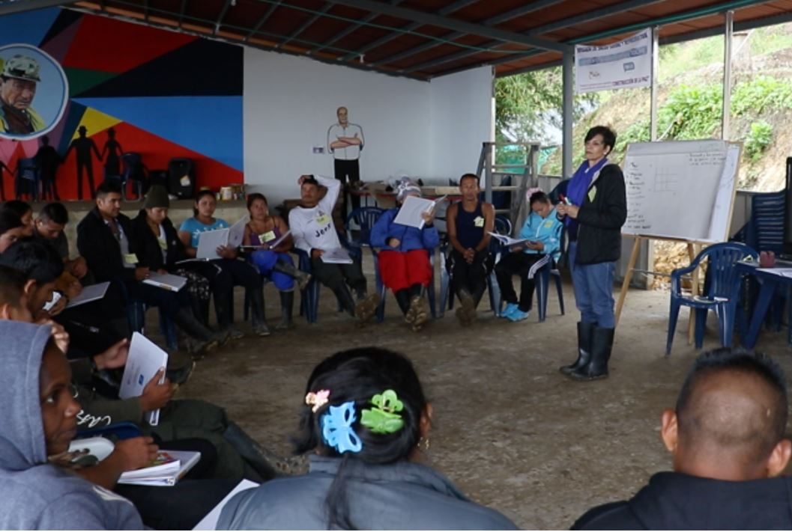
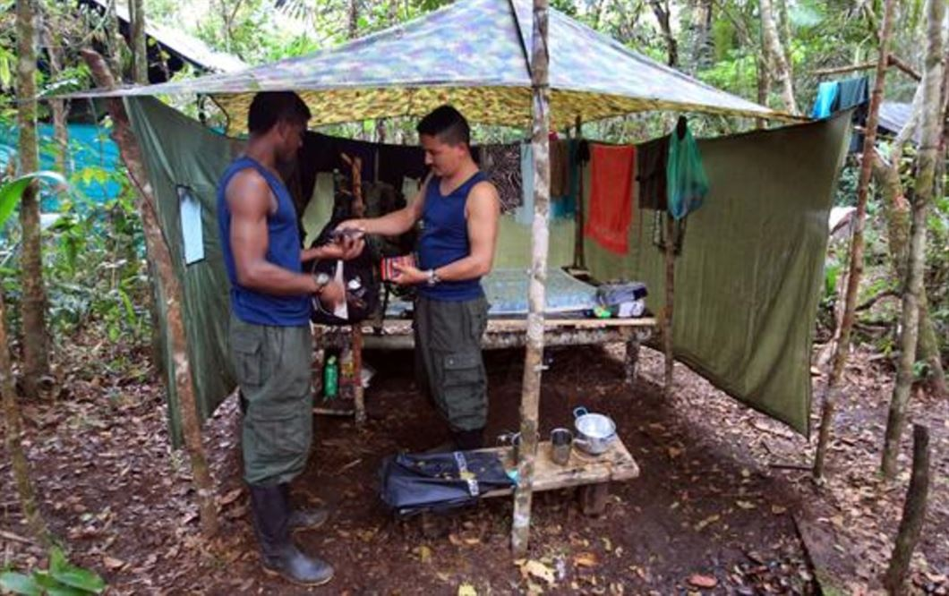
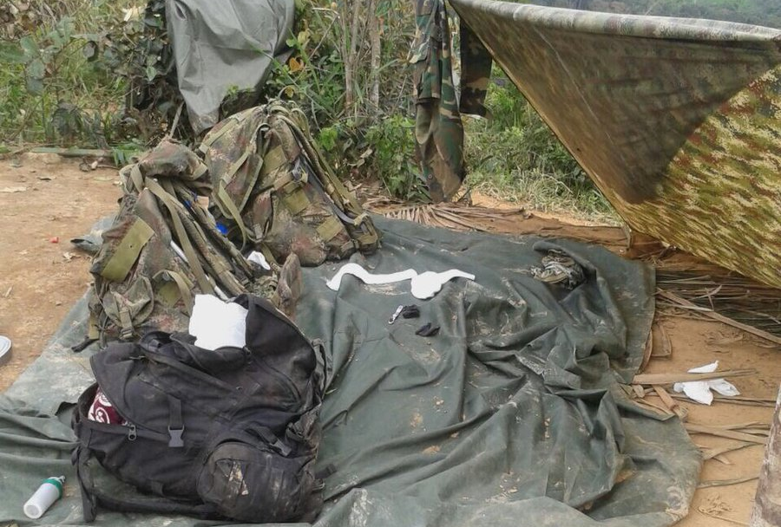
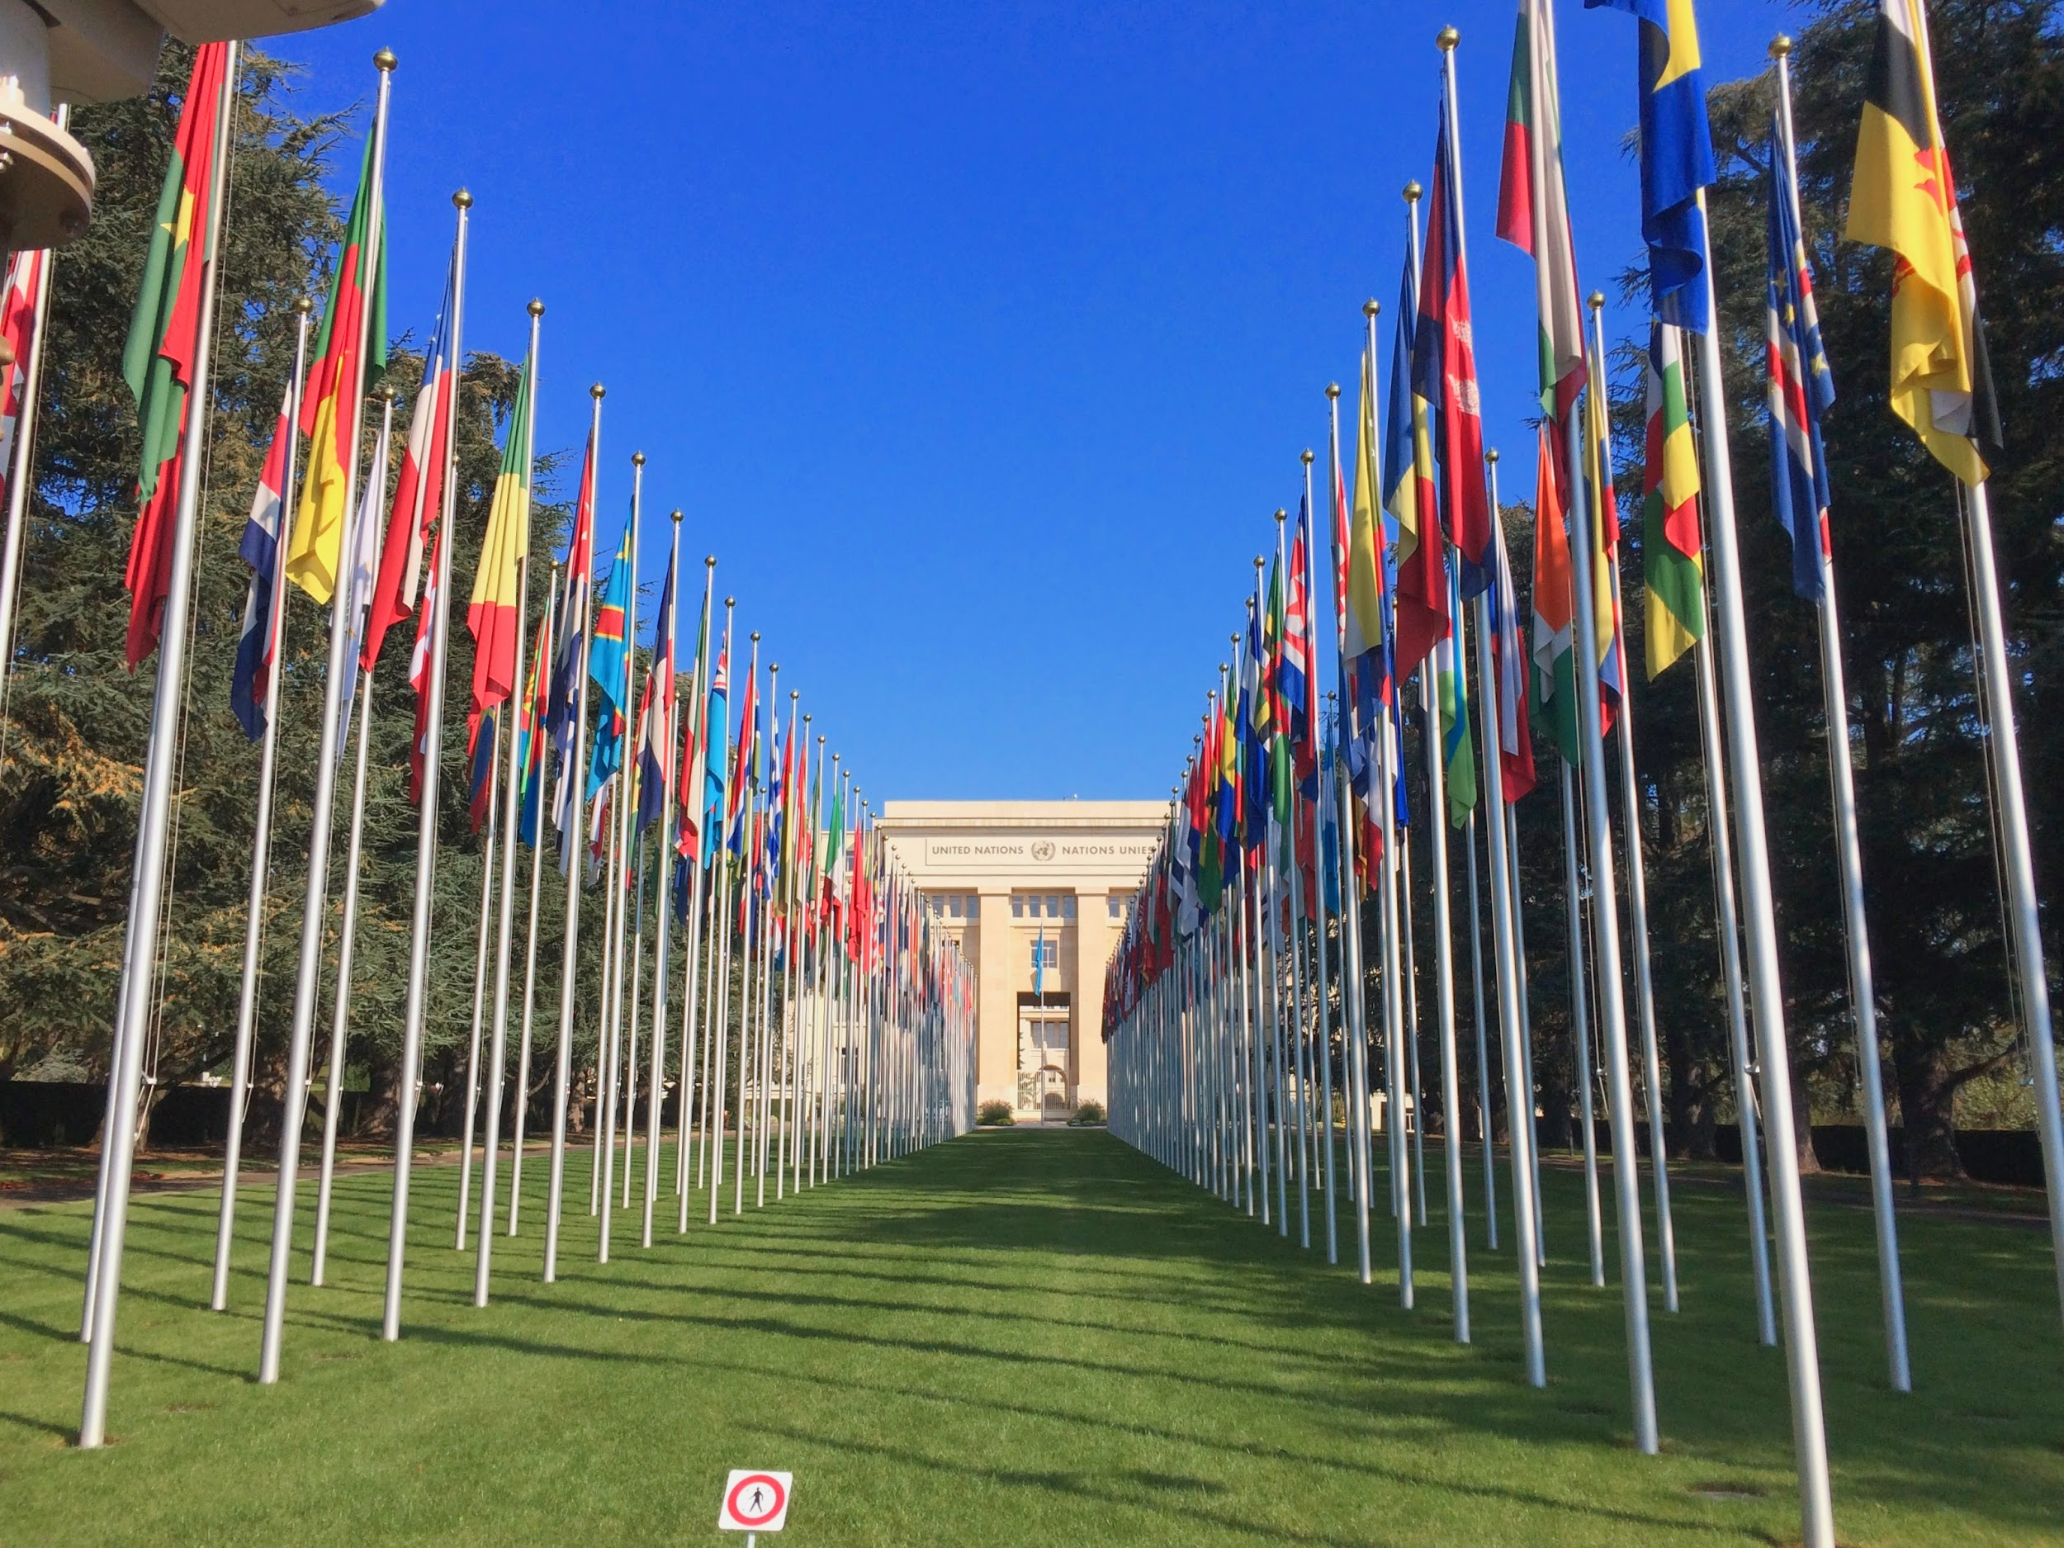
6.
Trials
of the peace process
7.
Tent,
Farc
Concept: Now that I have lost everything.
Concept: I’m someone.
9. Office of a great international institution.
8.
Cell
Concept: Time happens away from here
Concept: The great trick

Slide 11
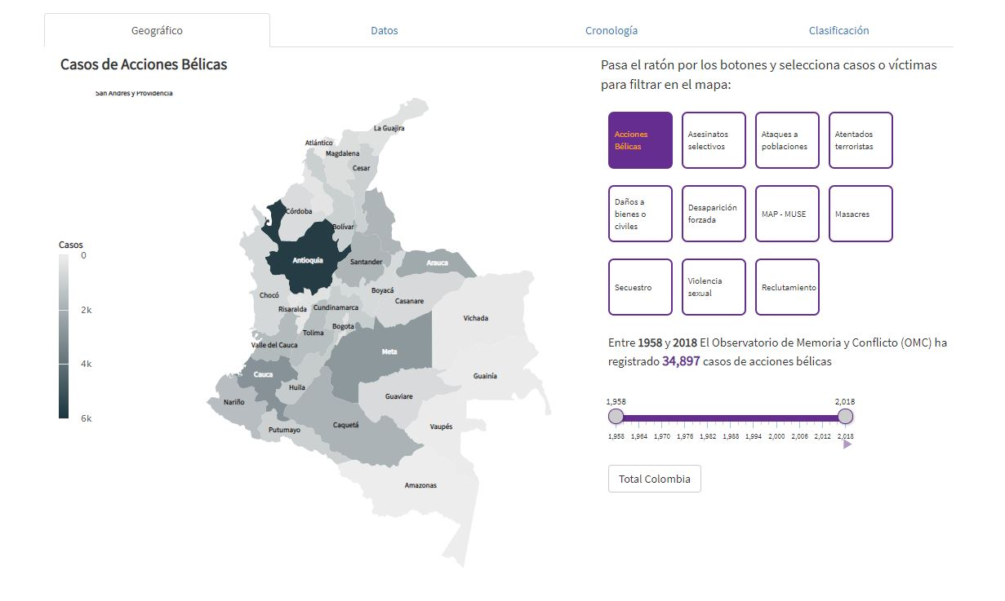
To visualize the multiple heads of the conflict click here: http://centrodememoriahistorica.gov.co/observatorio/bases-de-datos/geograficas/
Locations

Slide 12
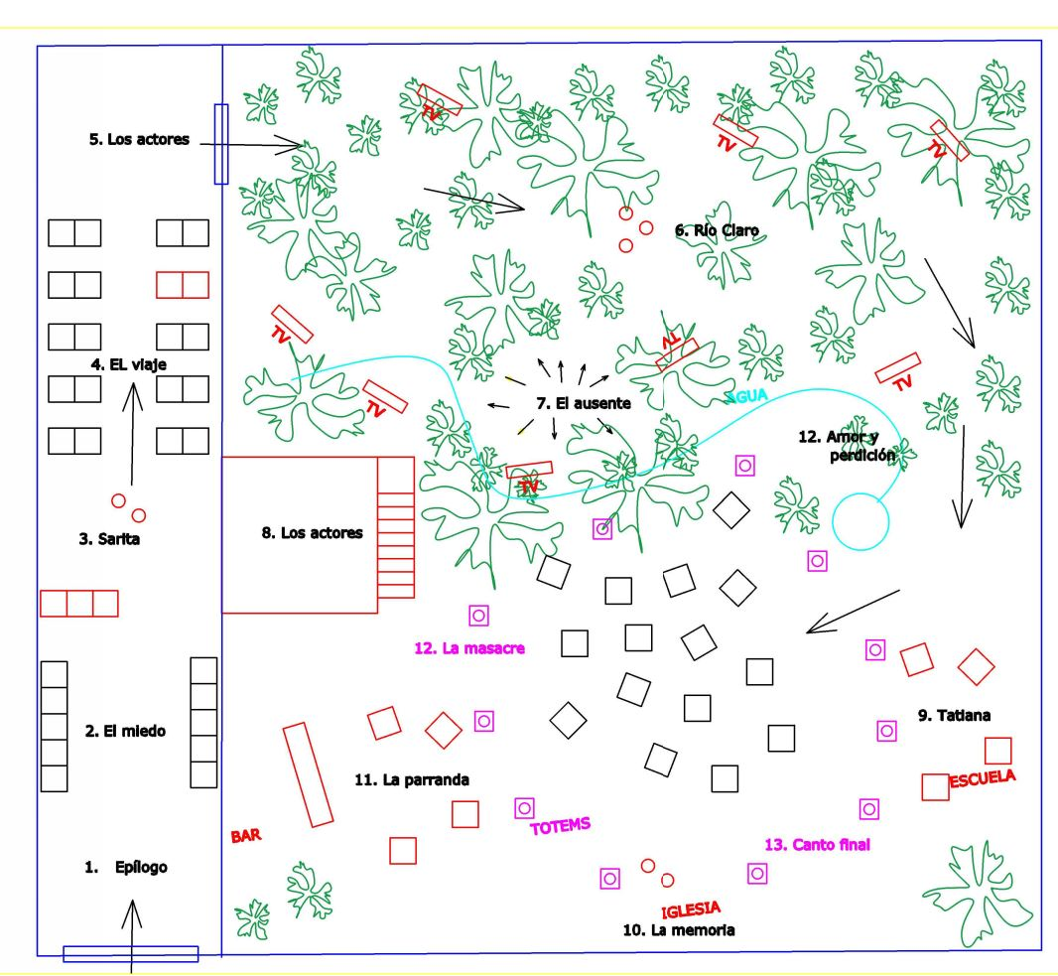
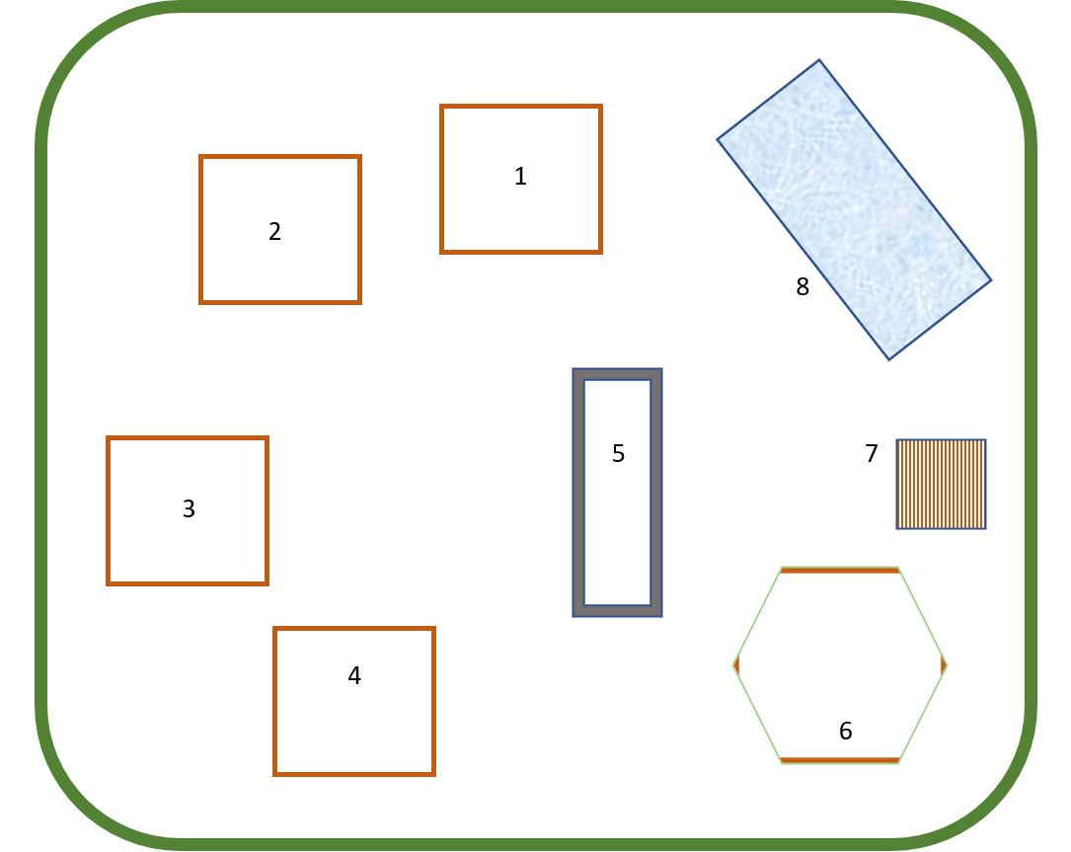
T h e S t a g e :

Slide 13
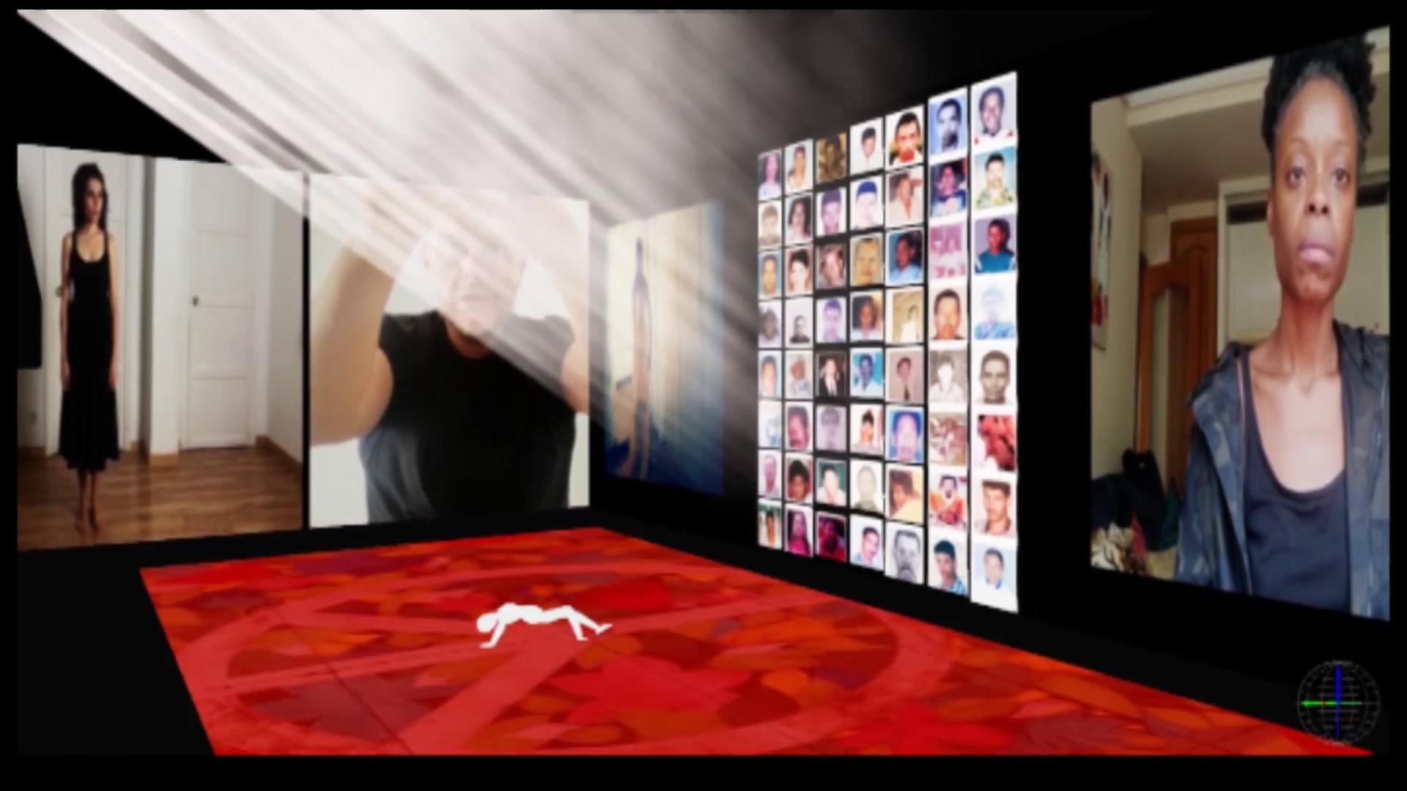
EL SALADO INSTALLATION
To visualize this laboratory material
click at the center of the video →

Slide 14
I D E A S F O R D I A L O G U E
Fragments of collective memory, inspired by and documented from the massacres of El Salado y Bojayá.
TERESA. I am Teresa, mother of Juana, the one that cried until going blind, because there are things that are better not seen.
SARITA. I was preparing the food, when I started to hear screams and gunshots. Something is happening… something happened, but I forgot because it’s better this way. Gunshots, so many that they sound like corn being roasted. Everytime they shout more. I don’t know how many hours go by, I exit to the street to inform they have killed my husband... No… I cannot believe… It can not be… ¡Juana!… I see her mom running, out of her mind in the middle of face down bodies and puddles of blood.
POLICE MAN. In this world all that is beautiful ends up costing one dearly.
PECOSO. (Howls three times) One morning Juana came out to give me from what she was cooking. She also gave me water. She would scratch my back, talk to me nice, and didn’t care I had my fleas.
CHORUS.
Run swiftly
Caress nervously
Sharp trembling
Violent loving
Sparkles
TERESA. The first thing I see when I get to the square are some black birds that circle in the white and dazzling sky. I cross the square going to the store. I run into her, there at the top, with the sunlight over her little head, she looks like the saints at church. Flies are everywhere and the vultures don’t come down, but as soon as they can, they will
tear out the guts and the eyes of all the dead on the square. The streets and the square are pools of blood with an unbearable smell.
CHORUS.
Why didn’t you scream?
Who was it? Who was it?
LILIA. I am Lilia, Juana’s half sister. My mom said that she got the chocolate father and I got the vanilla one. She was always hostile, always challenged me… little motherfucker... what coarse hair she had, I always liked to comb her hair. I gave my life for her.
PRIEST. That is what happens to you for being slutty, little girl. .
PECOSO. (Barks nervously). There are a lot of people. It smells like fresh meat, like blood. A little dish with fresh guts. It smells good and I search, I sneak in within the people. Juana is stiff, looking at the floor, on a blood puddle. Everybody looks at her and comments. I lick her little paw… she doesn’t respond.

Slide 15
CORO.
Mija, why did you go out so uncovered?
Did you get to confess?
THE PRIEST. My boys… on the one side the heads and on the other the bodies cut with a chainsaw. God keep them in His Holy Glory.
RAMÓN PÉREZ. Such a slut, she got herself pregnant from a guerrillo. That’s why I impaled her, so the girls in this town quit being whores.
LILIA. My little soul sister… I’ll take care of Romelia until the day I die. Motherfucking murderers! My sister! My little sister!
THE PRIEST. I’m the town’s priest. May God have her in His presence.
JUAN MALACOPA. Fuck off, this seems like market day. I walk towards the square, stayed drinking whiskey with my pal until late and I fell asleep on the table. Fucking militia… fucking militia, they tore the boys apart. They impaled Juana, that chick had just given birth. She still seems to look at us, that negra is still warm.
RAMÓN PÉREZ. It was me, Ramón Pérez, the greatest paramilitary boss on the Cóndores del Pacífico front. In charge of the actions charged to the Río Claro population on December 22nd of 2000. With a balance of 150 killed civilians, among them adult men and women. 5 comrades were reached by the army response, all of them mildly injured.
CHORUS.
Where did you go?
Why didn’t you say no?
THE PRIEST. When all had passed we bury her next to the oak at the square. I officiated a mass and that’s why they killed me with two gunshots to the temple the following week. They said to me: ‘This is sent to you, ass-kisser’. I had also baptised the boy who shot me.
Ángela breaks the fiction, the rest of the actors turn their backs to the audience.
ÁNGELA. Salado’s Massacre.. 16th to 21st of February of year 2000. Attributed to the paramilitary. They claimed the 5.000 inhabitants of the town were guerrilla collaborators. They arrived shooting at roofs. They got the population together at the soccer field. They cut off an ear of the first victim, they stabbed him, covered him with a black bag. They finished him off with a shot in the back of the neck. They kept killing them one by one with a list on their hand. They forced them to watch. They played bagpipes, drums and accordions in the background. They stole the instruments from the house of culture. They sacked, they got drunk, turned on the stereos on the houses at full volume. They put a peasant’s head in a bag and kicked it as if it were a ball. After they were finished with the men on their list, they followed with the women. They raped them, hung them from trees and impaled them. They blew off the brains of the president of the Communal Action with a blast of bullets. The one who shot him picked up the bits of brain and showed them to the others. “Look up so you learn what happens to friends of the guerrilla’’.

Slide 16
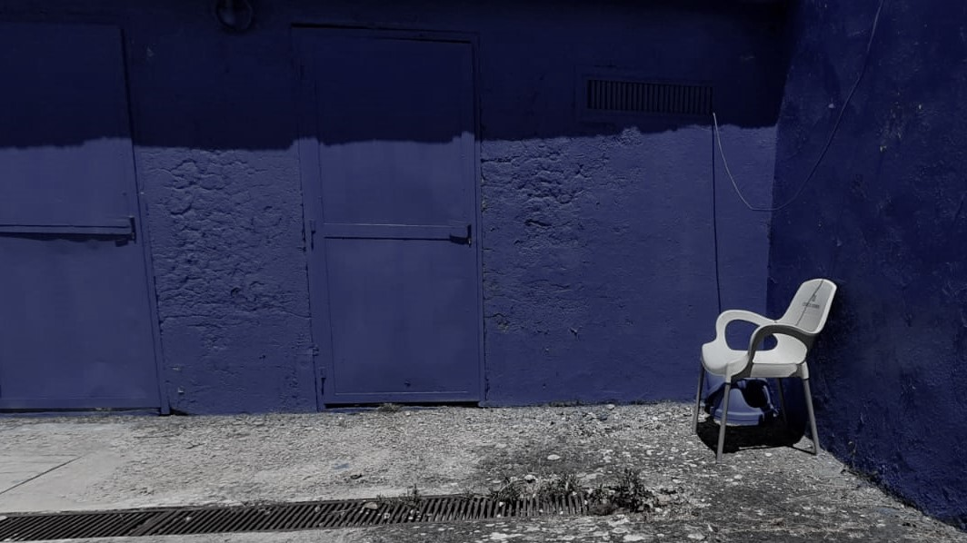
Team

Slide 17
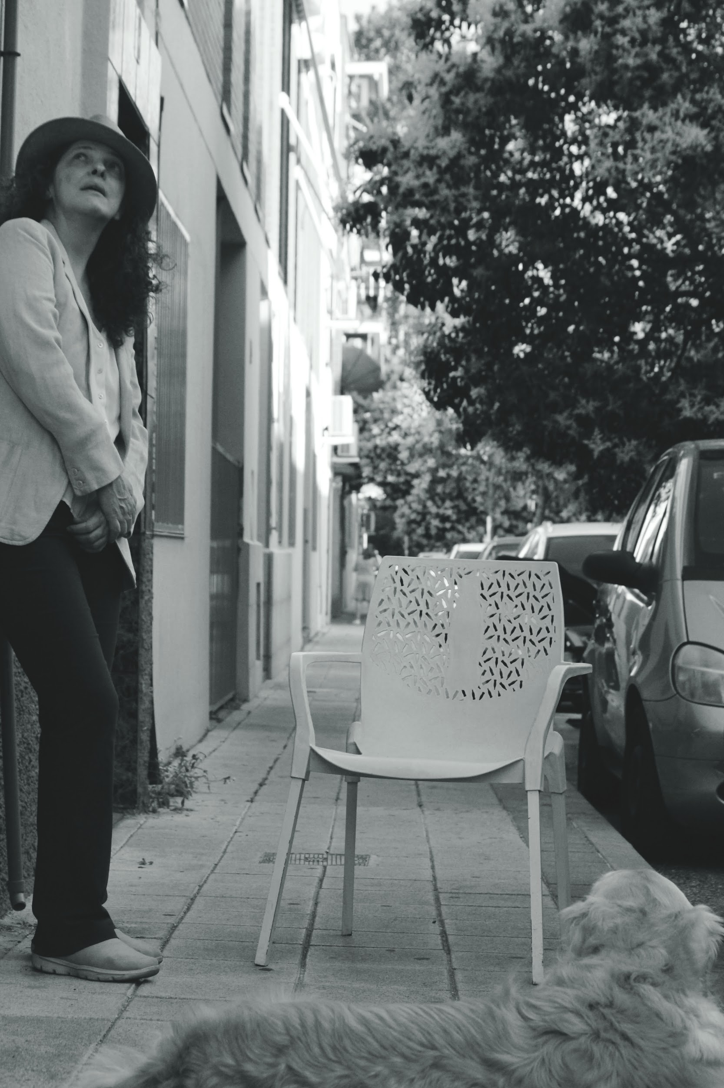
ROSARIO R. RODGERS (AAPEE)
staging
I carried out my studies at the National School of Dramatic Art in Bogotá, Colombia and for 32 years I have continued my artistic career in Spain where I have been co-founder of the La Abadía Theater and creator of Curtidores de Teatro. I have directed works among which are those of authors such as RM del Valle-Inclán, B. Brecht, S. Khane, T. Bernhard, B. Ortiz de Gondra, F. Arrabal, A. Lidell, BM Koltès. I have received numerous awards for the work I have staged as a director.
Part of the pedagogical experience I have carried out in conversations, assistances or exchanges with teachers such as Anatoli Vassiliev, Augusto Fernández, Mummenschanz, Grupo Odin Teatret, Franca Rame y Dario Fo, Richard Schechner, Ma. del Mar Navarro, Eugeni Bogdanov, Vicente Fuentes, Agustín García Calvo and several workshops about M. Chejov (Russia, New York, United Kingdom)
I am currently involved in this recent creation that talks about part of the history of a Latin American country. I also coordinate the La Abadía Theater Study Center.
Today more than ever I believe in education and artistic creation as a tool for transforming society.
AAPEE: Asociación de Artistas Plásticos Escénicos de España.Vicepresidenta.

Slide 18
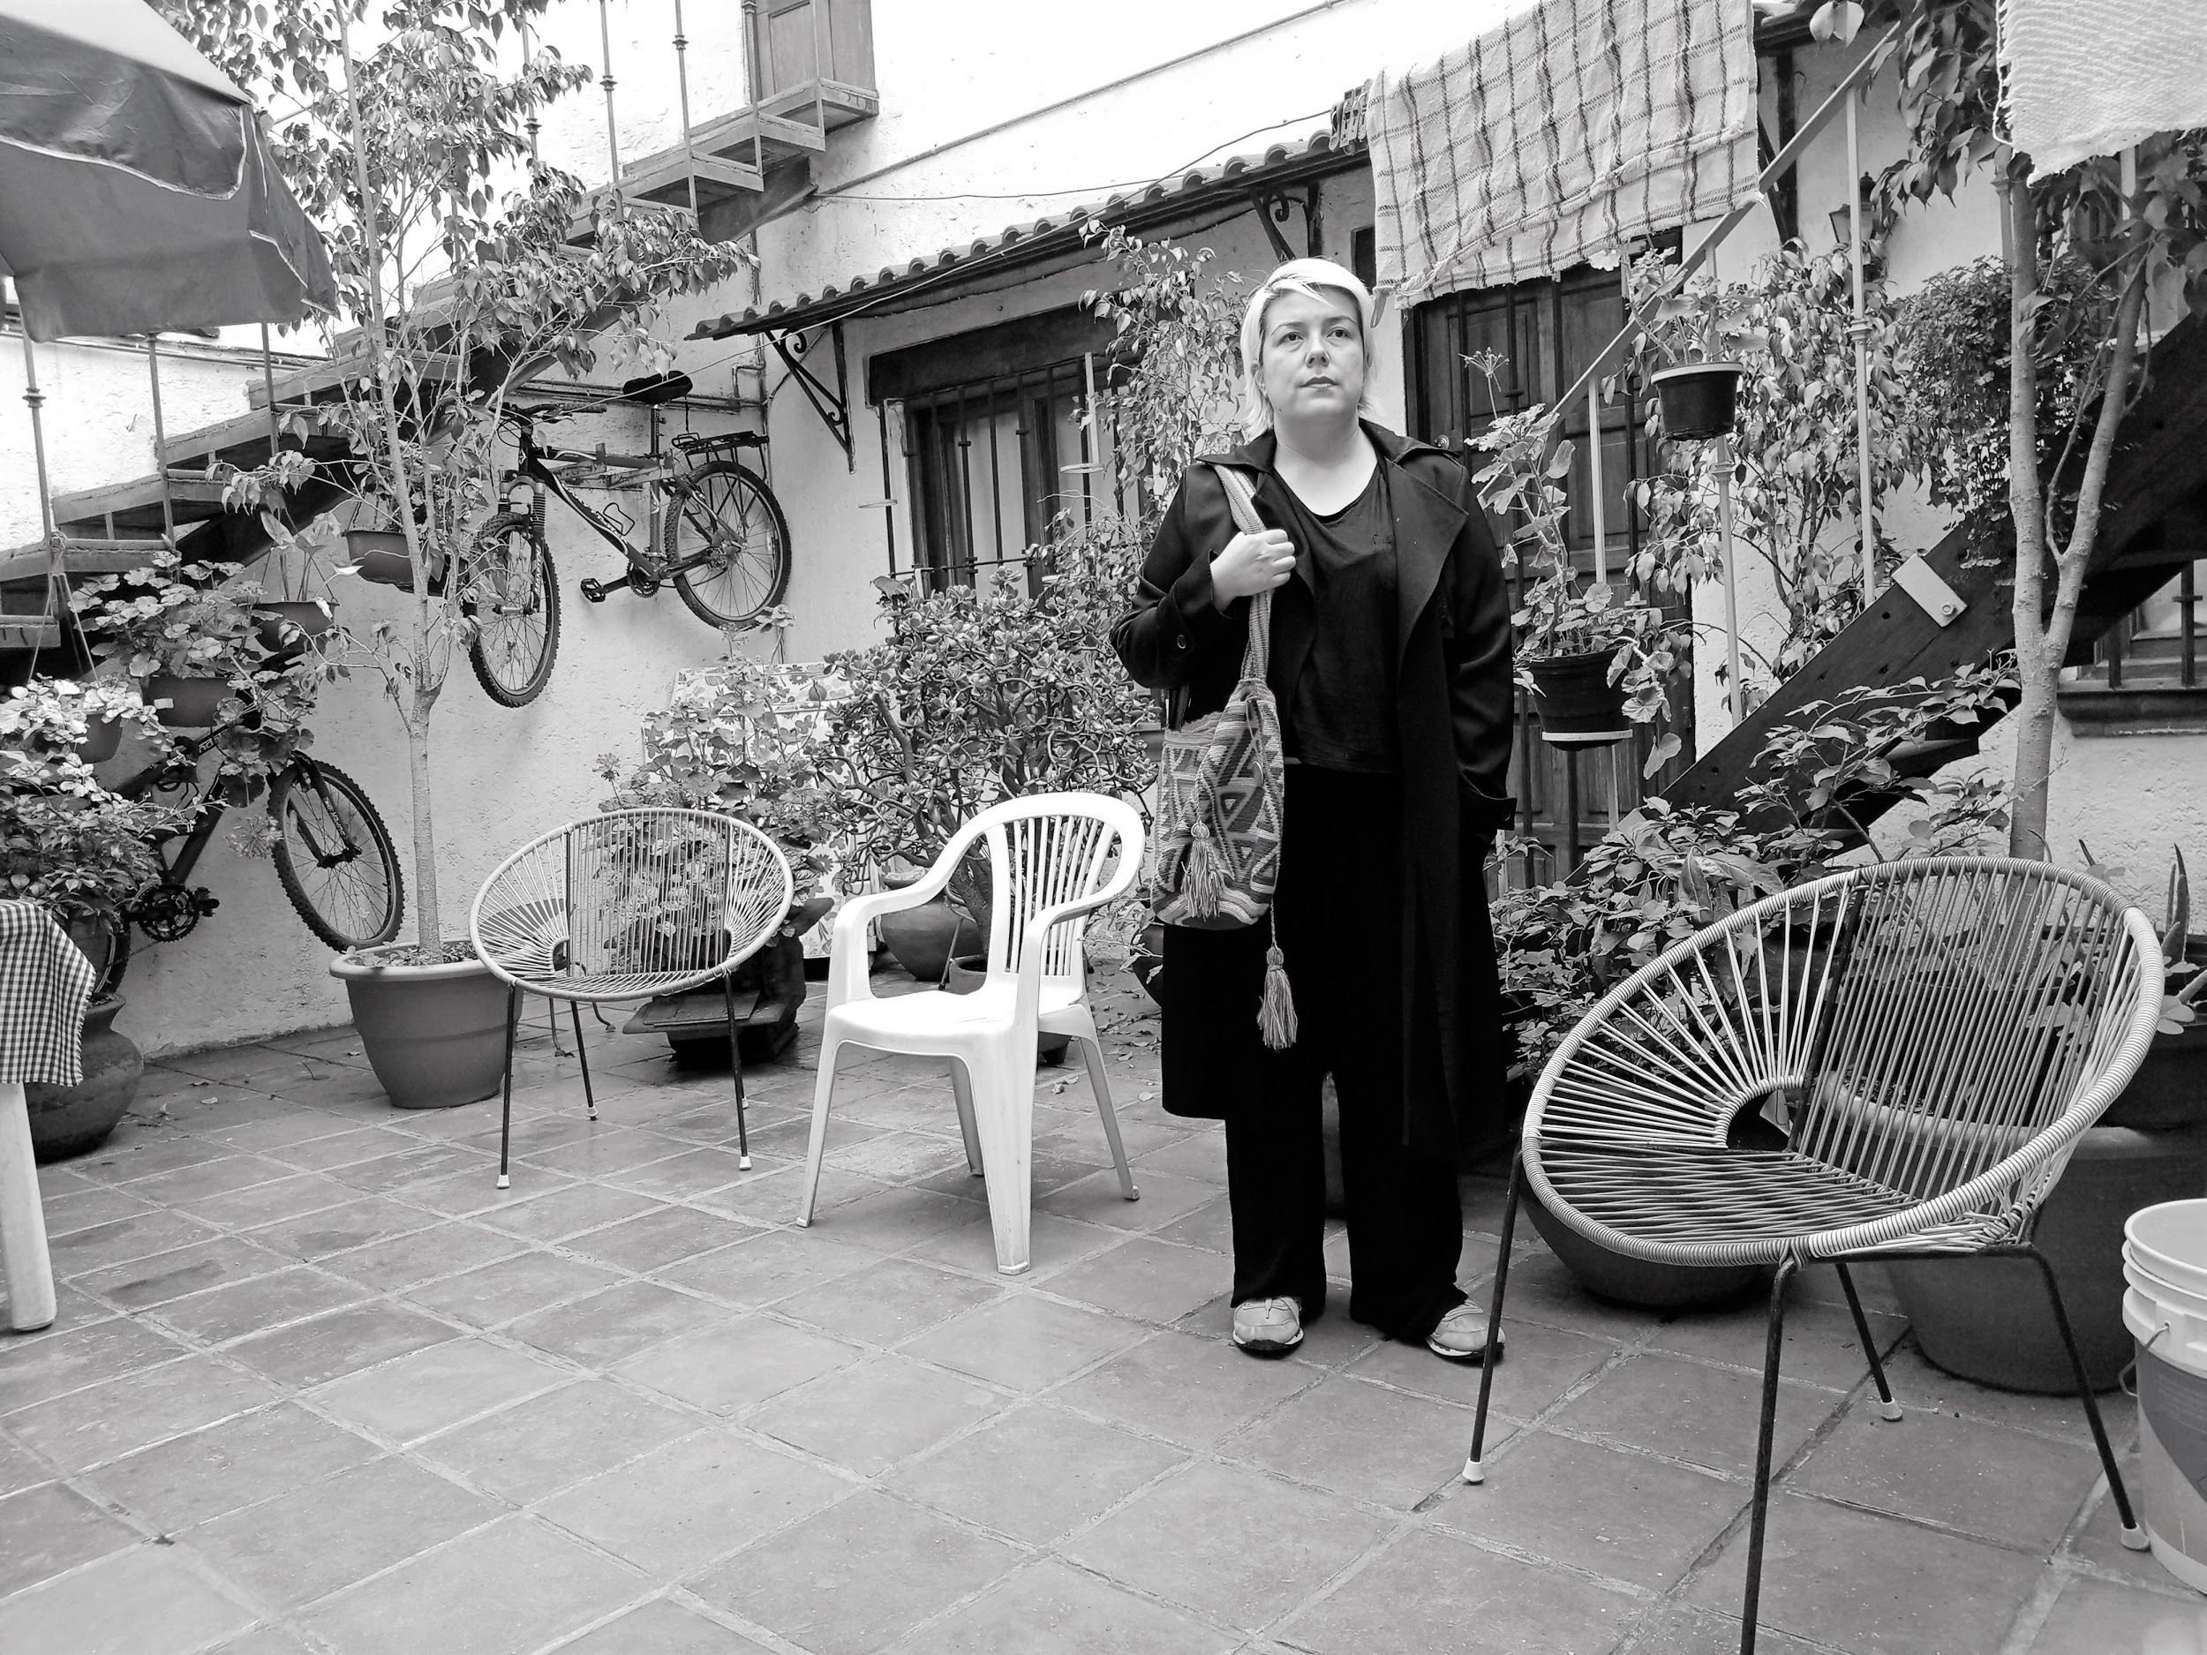
I am an actress, director and playwright. Graduated in Stage Direction and Dramaturgy from RESAD in Madrid. I do document theater because memory disconcerts me, who coined it and in what way. With my company La Máquina Poética, I carry out projects on memory with people and populations victims of violence. I have created two one-person pieces that speak of peasant women in Colombia. With these projects I have been in prestigious festivals and in patios in the middle of nowhere in the most remote places of Latin America.
I have been trained in Colombia where theater is a community and in Spain where technique is a centuries-old chariot in conflict with the past. I like Lope de Vega as much as the Teatro la Candelaria. I have worked for companies such as Micomicón, productions of the National Dramatic Center and the Juan March Foundation. As a playwright, I have participated in several creative projects, including: ETC creation grant of the Fourth Wall with José Sanchís Sinisterra, Dramaturgical research and creation project on Spanish exile in Mexico with the support of the Spanish Athenaeum, V Laboratory of Stage Writing of the SGAE and writing Laboratory ”Memoria de las cigarreras de Alicante” directed by Guillermo Heras.
As an artist, I am the conflicting sum of several countries: my Indian and blonde grandmothers who did not decide, my mother who was able to study but still militates in the shadows and a pair of wings to fly, fall and fly again.
CLAUDIA TOBO
dramatist

Slide 19
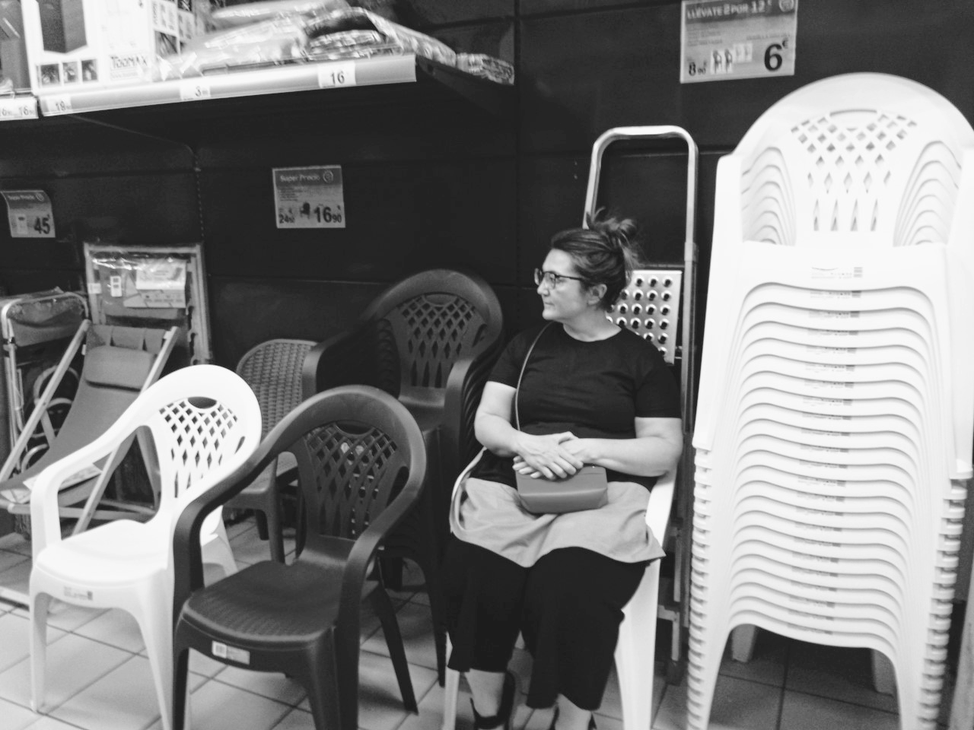
I studied Audiovisual Sciences in Madrid, Entertainment Sciences in Turin, Scenography in Dresden and I carried out a Master of Performing Arts in Salzburg. I worked for six years in Germany as a set designer and costume designer. I returned to Madrid in 2005, and since then I have been working in state theaters and independent companies. I am also a teacher of the Master of Scenography at the European Institute of Design. For seven years I have been collaborating continuously with the Lajoven Project. I received a Helen Hayes award in 2015 and an ADE award in 2018.
What I like the most is telling stories. Stories that open doors to other worlds and other realities. They can be classic stories, or contemporary, fictional or real, but they always have to ask me questions about the human condition.
In recent years I have collaborated more with theater groups that seek new forms of work, mixing research topics with personal experiences, posing new spatial dramaturgical challenges, such as the one that concerns us here.
SILVIA DE MARTA (AAPEE)
stage designer & figurine maker

Slide 20
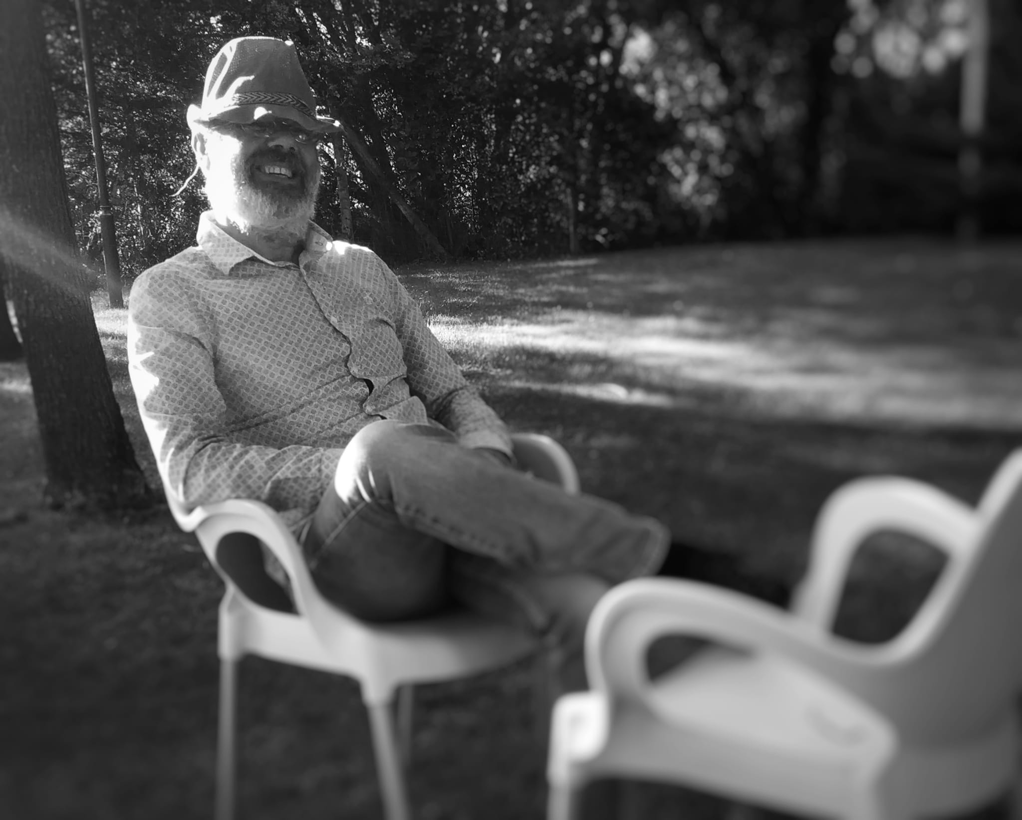
Since adolescence I have been passionate about cinema, photography and images.
In 1992 I combined my studies in Image and Sound with my first light designs for alternative companies and independent theaters in Madrid.
Later I collaborated with several Theater and Dance companies, such as Teatro de Danza Española, with which I toured around the USA.
My passion for image led me to the Madrid Community Film School, as part of its first class, where I graduated as Director of Photography.
At the end of Film School, I worked on several projects, such as ”La guerrilla de la memoria” produced by Montxo Armendáriz, or the Photography Direction for ”El Cielo Gira” (2004) nominated for best photography by the Círculo de Escritores Cinematográficos and winner of
various international awards such as the prestigious Rotterdam festival.
I find that the opportunity to unite the two worlds is what interests me most professionally, (stage and image) and I begin a long and regular collaboration with El Gran Teatre del Liceu, carrying out for over a decade the Direction of Photography of a large number of operas for recording and broadcast in cinemas, as well as collaborations as Lighting Designer with directors such as Calixto Bieito, Emilio Sagi, Joan Font, Joan Anton Rechi, Gilbert de Flo, or Ivo van Hoe.
Among my latest works there are: a formidable experience with Isabella Rossellini and her ”Link-link circus”, Madama Butterfly by Joan Anton Rechi, with whom I got to know the Muscat Opera House, at OMAN. El Dúo de la Africana, with Joan Font, for the Oviedo Opera, or ”What Ever Happened to Baby Jane?” with Vicky Peña and Carmen Elías.
These were rewarding experiences both professionally and personally that have led me to visit theaters such as La Ópera de Paris, La Fenice in Venice, the Opera in Turin, La Ópera in Palermo, the Teatro Real in Madrid, La Maestranza in Seville, Teatro Arriaga in Bilbao, the Julio Mario Santo Domingo Theater in Bogotá ... and many others that I hope and wish to continue visiting thanks to this profession that I love intensely.
CALAMAR, Alberto Rodríguez
light designer & video (AAI)
AAI: Asociación de Autores de Iluminación

Slide 21
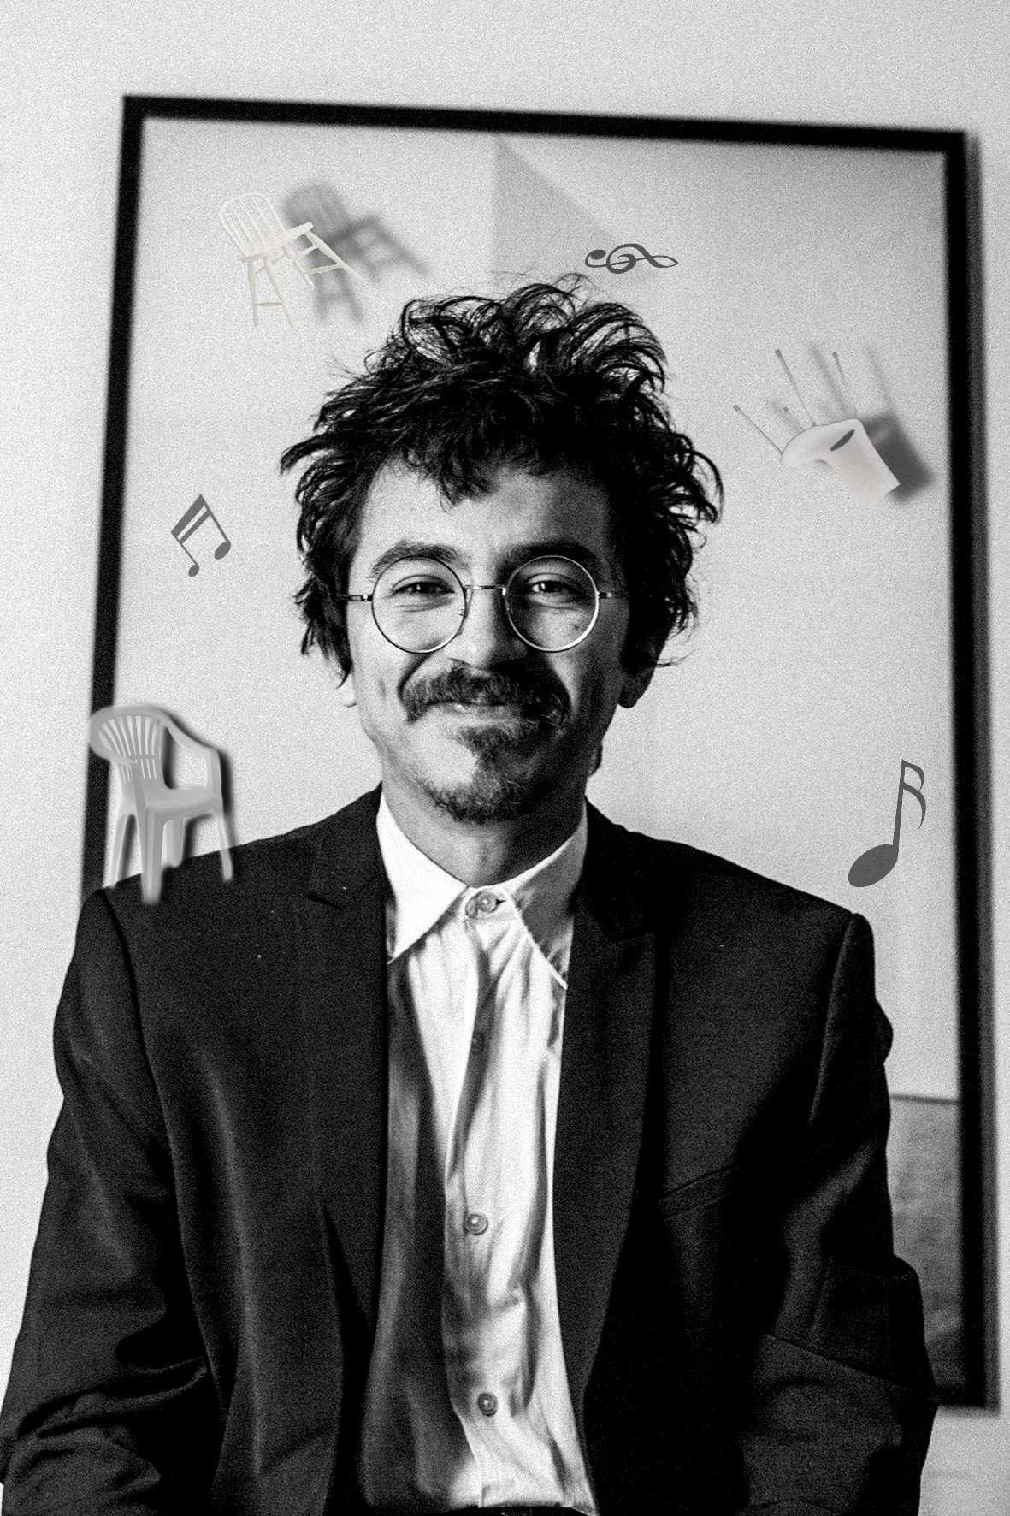
(Ibagué, Colombia, 1985) I am a musician and entertainer. My music collects and explores elements of Andean and Afro-Antillean popular music, sound experimentation and Colombian folklore. My songs are loaded with humor and surrealism, and I try to create a mythology of my own. I have played at festivals such as Sónar Reykjavik (Iceland, 2018), Sónar Barcelona (Spain, 2017), RBMA Montréal (Canada, 2016), among others.
I have been part of the Orquestina de Pigmeos Theater Company on different occasions and have been a resident with their project Islas Atlánticas in Naves Matadero (Madrid, 2018) and as part of the project El Triángulo - An artist works here by CA2M (Móstoles, Madrid 2018 , 2020). Among my latest publications are a music production with the Japanese Ryota Miyake (as the band Flash Amazonas) and a book-album with Colombian musician Andrés Gualdrón (Atlantic Islands).
In November my new album Cuando tengo fiebre veo la cabeza de un leopardo magnífico will be released released by the Lago / Crater label.
JULIÁN MAYORGA
musician

Slide 22
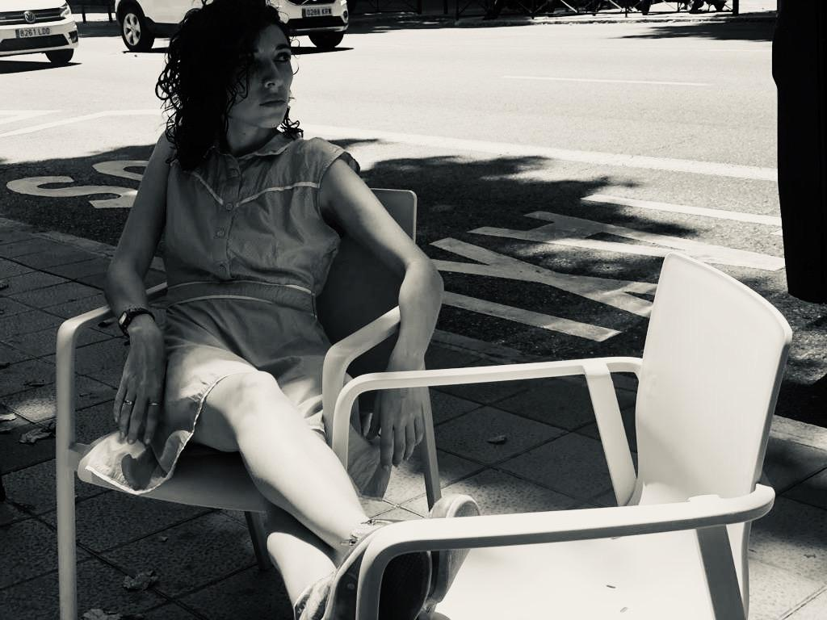
I was born in Bogotá - Colombia. I have a degree in Social
Communication from the Javeriana University, and a Scholarship from the Carolina Foundation to complete my Master’s in Audiovisual Production at the Complutense University of Madrid and the IORTV.
I am an actress trained between Colombia and Spain with teachers such as Victoria Hernández (Acting) César Vadillo (Text) Gabriel Olivares (Suzuki and View Points), Alejandra Barbarelli (Spontaneous Theater) Lucía Miranda (Documentary Theater and Periodic Theater) Graham Dixon Michael Chéjov London Studio (Chekhov Technique) among others. I have trained in dramaturgy with Paco Bezerra and Carlos Contreras within the Rivas Cherif Laboratory of the National Dramatic Center. I am an author and a sort of poet, especially interested in documentary theater in which I ventured with my MA work.
I am an art educator at The Cross Border Project and co-creator of ES TU (YO) intercultural mediation. My work has been and is oriented towards diversity and migration, towards music, writing and art-education.
I am in love with my roots, and with theater and its transforming power.
ARI SAAVEDRA
performer

Slide 23
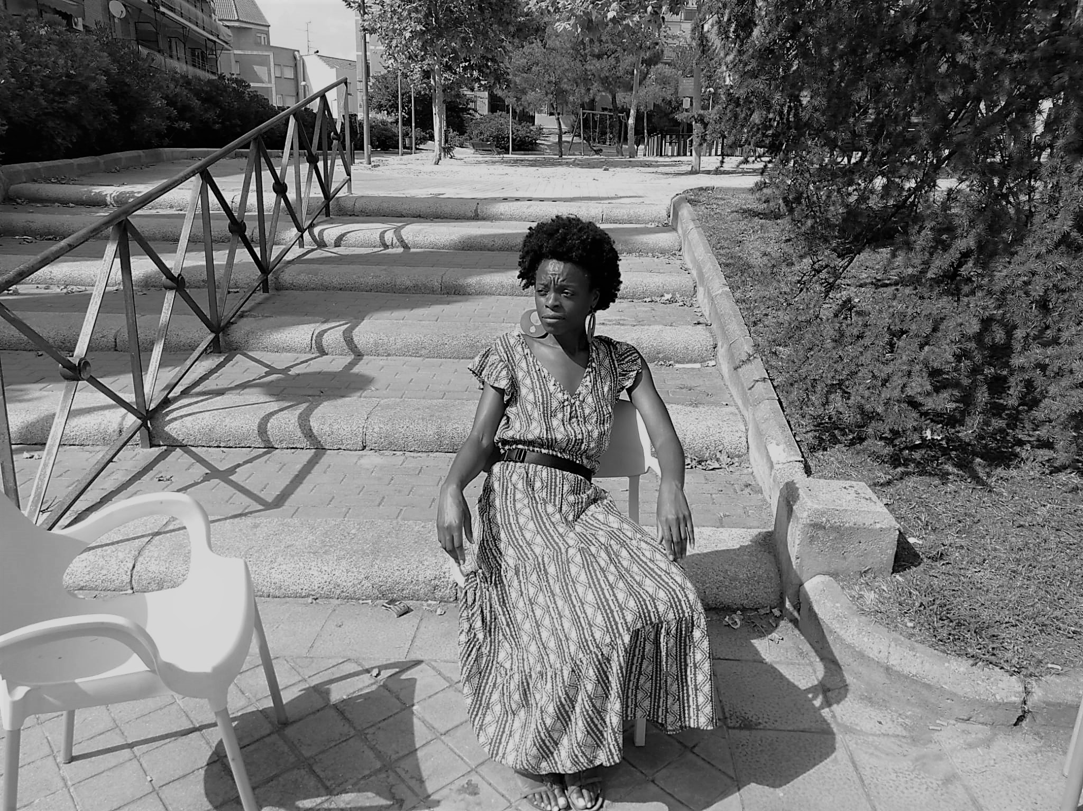
I am a singer, and from music I went into acting. As a singer, I am in charge of my personal project called Astrid Jones & amp; The Blue Flaps, with which we have released our first album, “Stand Up”, and I am part of the Gospel Factory choir, with whom I have worked for artists such as Pitingo, Beatriz Luengo, Raphael, Marta Sánchez, among others.
As an actress, I have taken part in the plays "An invisible piece of this world" written and performed by Juan Diego Botto and directed by Sergio Peris Mencheta, "Aquiles y Pentesilea" directed by Santiago Sánchez for the Centro Dramático Nacional and “Para Nenas Negras” by African-American writer Ntozake Shangue that have really left a mark on me.
Everything that delves into identity awakens my curiosity, perhaps because of my very condition of having been born in Spain and coming from a Guineo-Ecuadorian family.
I have been lucky enough to tour in several Latin American countries, including Colombia, and the energy that beats in those parts has always caught my attention – the way of living, building, its musicality and its diverse essence. This project gives me the opportunity to enter the universal of the human being from the particularity of its history and I am very grateful to have received this invitation to be a member of this adventure.
ASTRID JONES
performer

Slide 24
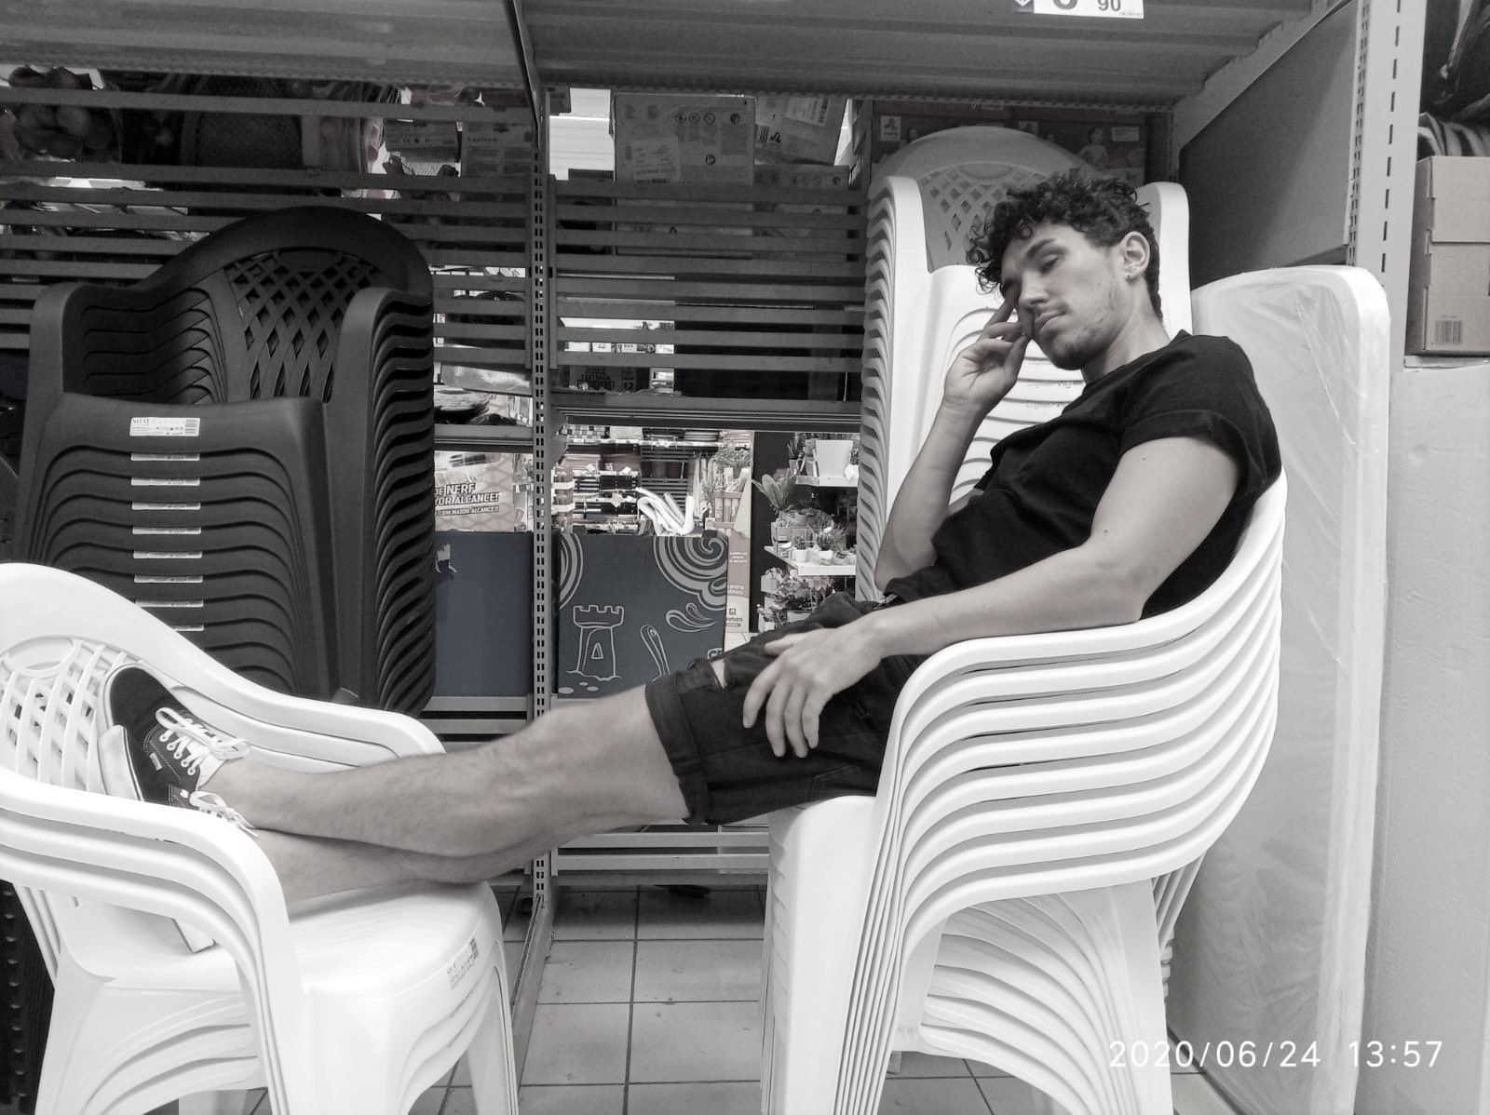
I am Daniel Cuadrado, a lover of the art of acting raised and settled in Madrid. Since I can remember, I recall "why?" and "what for?" being the two questions that have accompanied me the most throughout my days. My mother was the first to suffer them, then my friends, and co-workers and some girlfriends, later.
I feel an inexhaustible restlessness to try to understand everything about everything, with a special predilection for the behavior of human beings. In my early twenties, after some coincidences that were miracles for me, I found a refuge for some of my concerns in the performing arts. This is how my stage of training in theater began in different schools such as Estudio Juan Carlos Corazza and at the hands of several teachers such as Carlos Silveira, Fernando Piernas, Antonio del Olmo, Andrés Waksman or María Bigeriego.
Now, and thanks to the proposal of Curtidores Teatro, a whole team launches to investigate the questions that Colombia and its history raises to understand myself, understand you and understand each other better.
DANIEL CUADRADO
performer

Slide 25
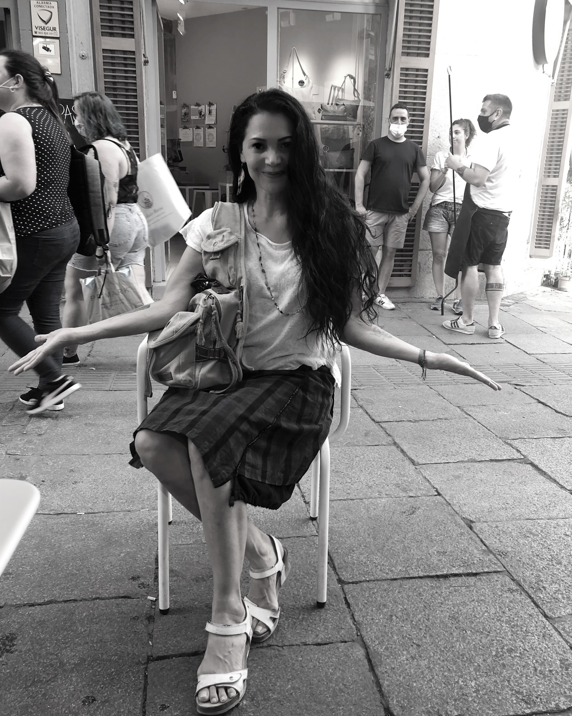
I was born in Cali – Colombia: a hot, beautiful, happy city and above all very dancy. I fell in love with dance from a very young age, and I’ve been constantly fighting for it until now. The theater came later, as a consequence of expanding the language. I have combined dance, theater, direction and dramaturgy for 30 years. I was lucky to start with great professionals.
Life led me to receive training and influence from countless directors, with whom I also had the fortune to work, such as Tino Fernández, David Ottone, Santiago García, Alfonso Ortiz, Enrique Vargas, Romeo Castelucci, Anna Redi, Ricard Salvat, María de Ávila Madrid Superior Dance Conservatory, Cristine Tanguay, among others.
I have been able to take my work to the national and international scene. I received the best director award at the 11th National Theater Competition for Stage Directors Torrejón de Ardoz Madrid. I have been published several times with narrative and dramaturgy, and I want to continue to do so. Writing is my passion. I run the company Dragones En El Andamio.
I was lucky to come across this beautiful project, so full of possibilities, and above all so useful. I thank Rosario for her trust. I think her purpose is more than necessary. And I'm lucky to be included in it.
MARISOL ROZO
performer

Slide 26
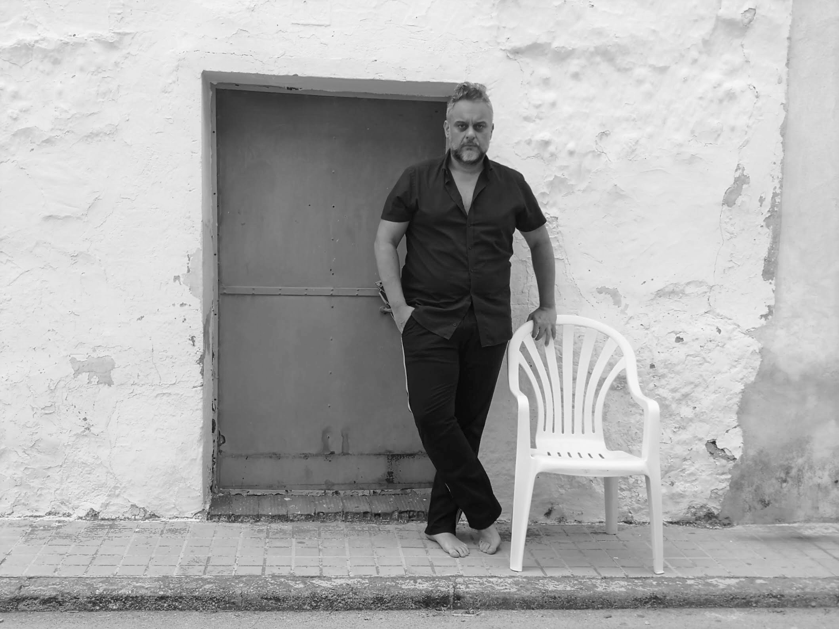
I am Raúl Tirado, an actor from La Mancha graduated from ESAD in Córdoba (Spain). 6 years ago I crossed the pond and today ... America vibrates under my skin. Mexico offered me learning, meaningful experiences and original content during five years; earthquakes and life lessons included. One of the experiences that most marked me was the season of La casa del desagüe, on Morelos, with which we performed every Sunday for 400 people who came expectantly under the exhausting midday sun in Ecatepec, one of the most dangerous areas in America. The audience was impeccable.
My last works in Mexico were Herederos por Accidente and El César for television and Tandas y Tundas for theater, directed by Arturo Beristain, with several seasons and awards (ACPT and APT 2016). I also participated in the films Ocho de Cada Diez by Sergio Umansky and Aguerñados by Leandro Córdova.
I toured Quintana Roo and the State of Mexico with theater tours, I did seasons in CDMX and Hidalgo and interventions on Mexican TV and cinema. In Spain I went through the Almagro International Classical Theater Festival and I also participated in tours, for example with Príncipe y Mendigo (Teatro Rojas de Toledo Award for Best Show in C-La Mancha 2012) and took part in seasons with, among many others, Amelia Ochandiano or Manuel Galiana. Lately I trained with Boris Schoemann in CDMX and with Guillermo Cacace or Marco Antonio de la Parra, among others, in Buenos Aires. Also, in those years I got to know Cuba, Colombia, Peru, Bolivia, Argentina and Uruguay.
A year ago I spent 23 days in Colombia and today the Theater continues to teach me about this country and its people. Those unsuspected paths now serve to illustrate a message of repair.
Kampa temoj pili iuam inam...
RAÚL TIRADO
performer

Slide 27
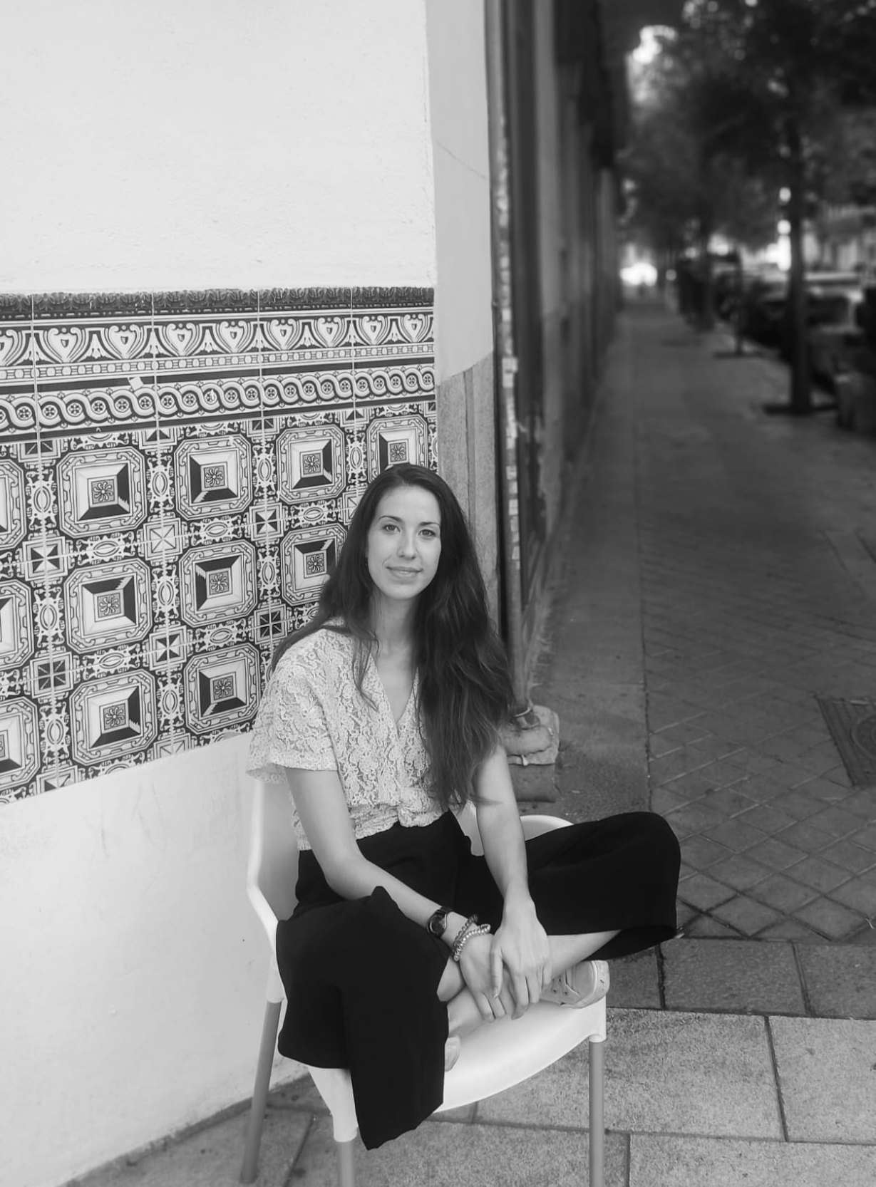
I trained in Production and Management of live shows at the Madrid Center for Entertainment Technology, dependent on the National Institute of Performing Arts and Music.
My interest in promoting artistic activities and cultural manifestations – which I consider contribute to the human and social development of the members of a community – has led me to continue my studies in Cultural Sciences and Cultural Diffusion. I have come here driven by my artistic experience in the world of dance.
After graduating from the Professional Conservatory of Madrid with the End of Degree Award, I worked for more than eight years as a dancer in companies in Russia and the Czech Republic. During this period, I had the opportunity to get on stages in almost twenty countries and learn about different customs and ways of life, which fueled my interest in other communities. It was on these tours that I met all the trades on the scene and that awakened curiosity in me, in particular about management and production.
I see the Performing Arts in every possible manifestation as an element of support in giving a perspective of social realities and promoting evolution and change.
ANA GÓMEZ SALAMANCA
executive production

Slide 28
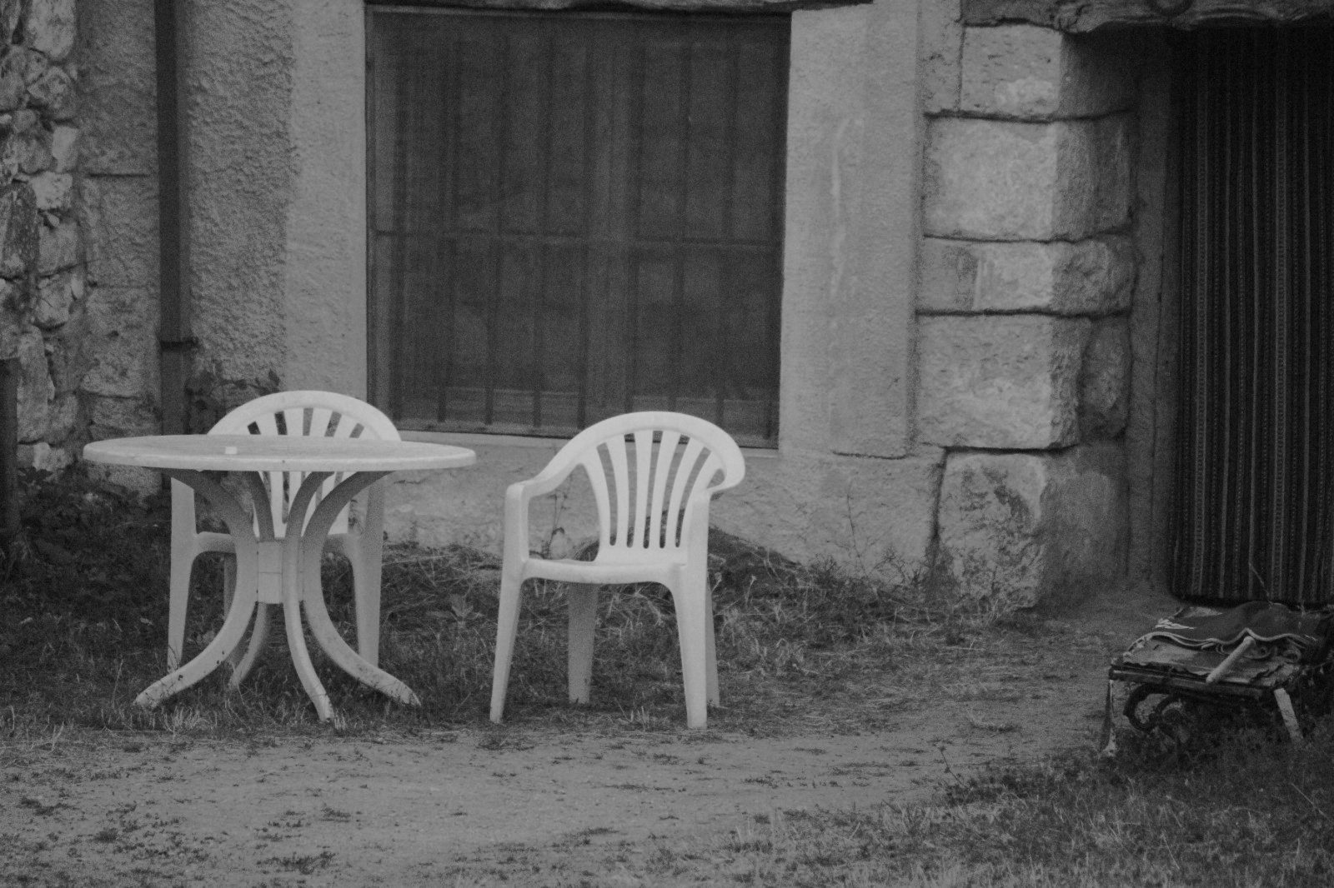
External look:
Borja Ortiz de Gondra, dramatist
Nilo Gallego, musician
Practices in Set Design & Costume Design:
María Alejandra Sánchez
María Camila Suárez

Slide 29
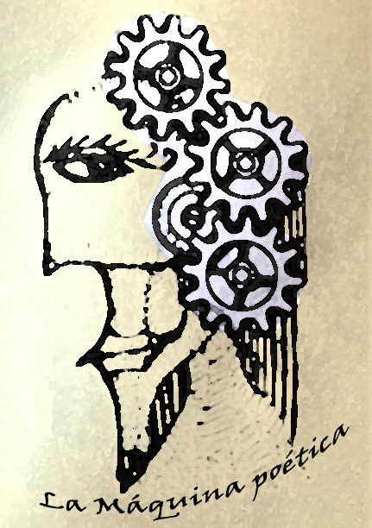
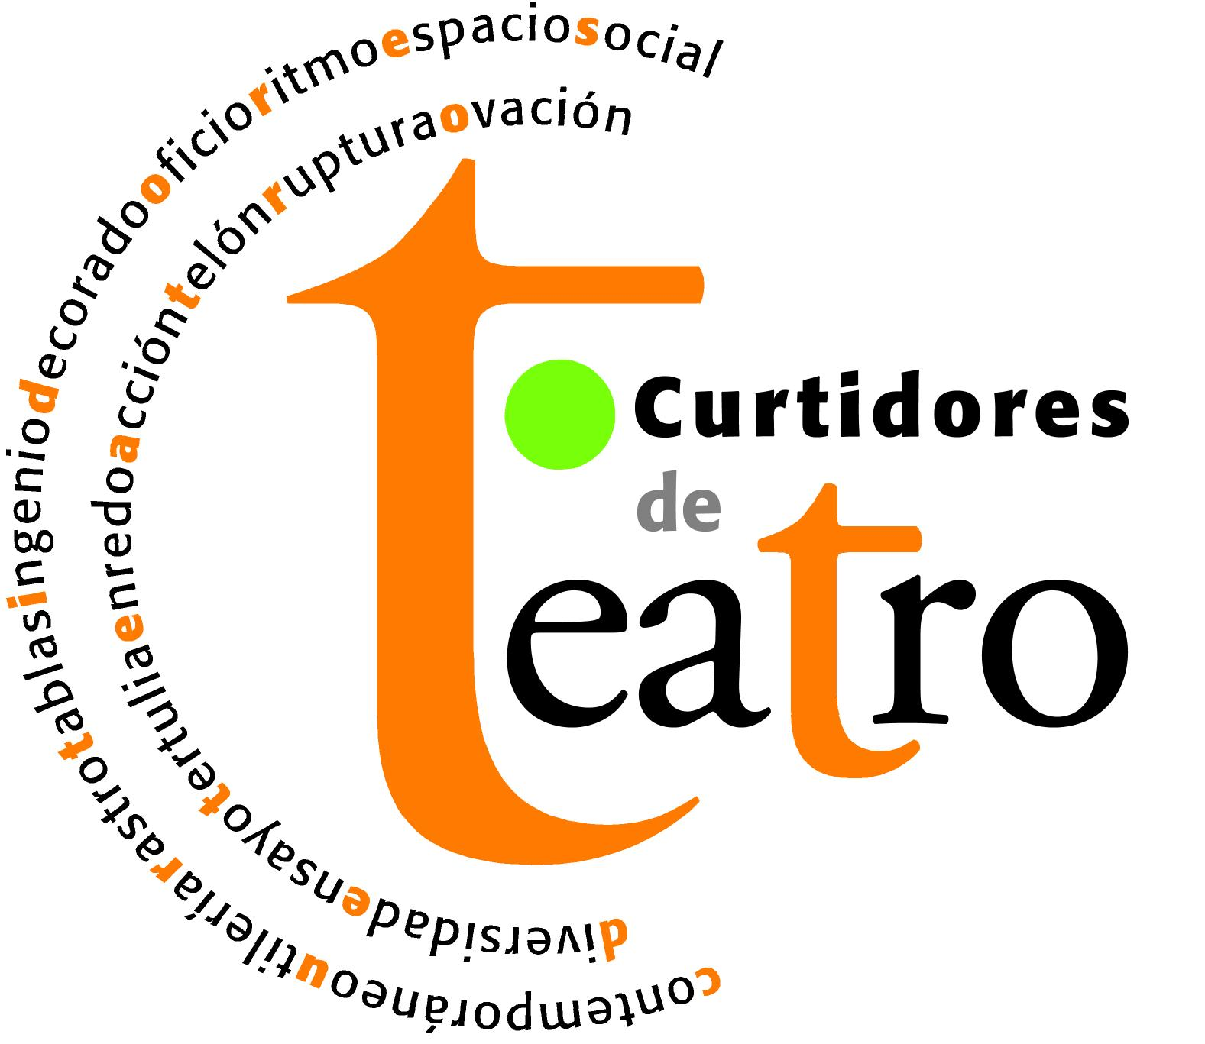
TRAVEL FELLOWS
Project conducted with the support of the program of Help to the Contemporary Creation and Mobility of Madrid City Hall ( Ayudas a la creación contemporánea
y la movilidad del Ayuntamiento de Madrid.)

